Slide 1

Web performance the red list
@trkhanh8@github.com
Notes:
hey folks so let's talk about the cost
of JavaScript's building interactive
experiences on the web today usually
involves sending an amount of JavaScript
down to your users often too much of it
so today we're gonna talk about why
javascript has got such a high cost and
a few things that you can do to work
around that and still give your users a
really good experience so as was
Mentioned.
I have opportunity to work on performance topic.
I spend a lot of time reading on web performance and
more frequently you know things that
they can do to improve the size of their
JavaScript bundle.
From this talk today there's two things that I'd like
you to remember the first is that small
JavaScript bundles can improve your
download speeds they can lower memory
usage and they can reduce CPU costs this
is going to be particularly important
around mobile memory costs come into
play when we think about the
uncompressed size of scripts that
scripts the last be stored in memory the
second thing that I'd like you to
remember is that post download executing
JavaScript is now the most dominant cost
and so it's important to keep that
minimal

Slide 2

CLEANING UP YOUR JAVASCRIPT 6 MONTHS IN

Slide 3
IF JS DOESN’T BRING USERS JOY, THANK IT AND THROW IT AWAY

Slide 4
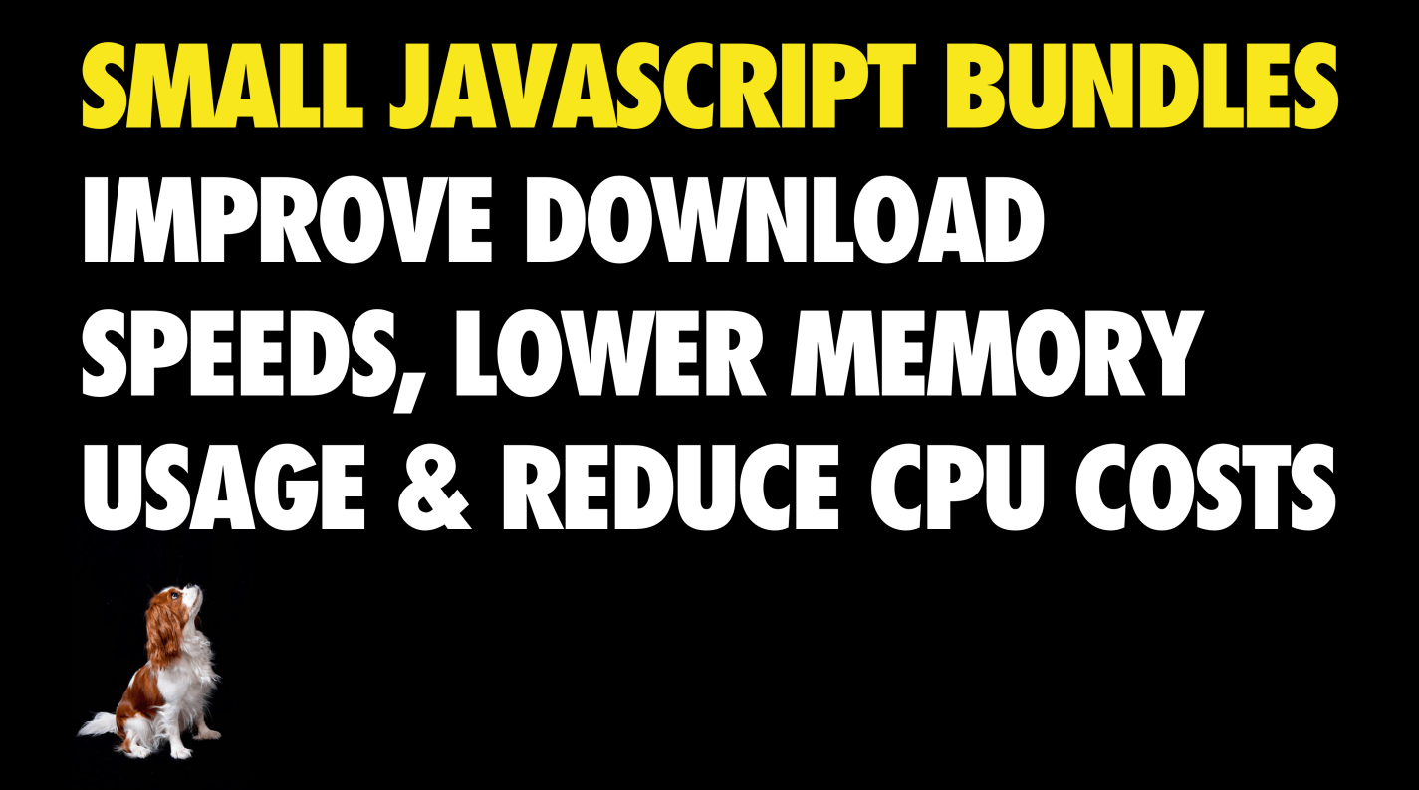

Slide 5
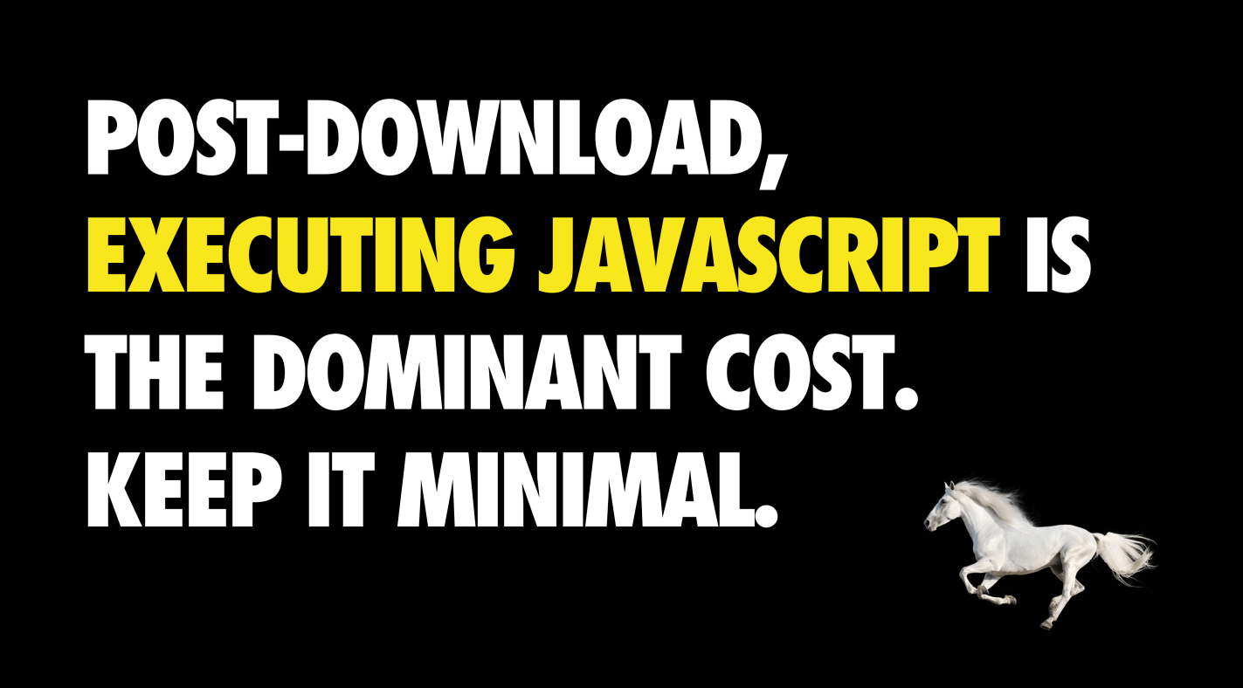

Slide 6

Notes:
In the past if you've read any
of the articles about the
cost of JavaScript to place a heavy
emphasis on things like parsing and
compiling code that phase is now a lot
faster in browsers and so execution time
is something that we need to pay
attention to so let's dive into two
topics network and compute
now network is all about you know trying to get
bytes over the wire how do we get our
JavaScript down to those devices the
users are gonna be checking you know our
experiences out on and compute is how do
we actually process that javascript in a
efficient way so let's start off with Network

Slide 7
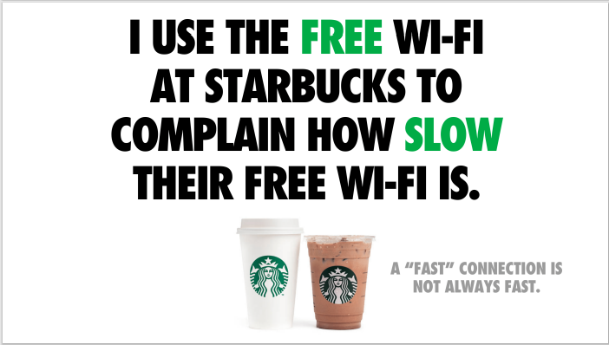
Notes:
Network now as we've seen from some of
the talks yesterday a fast connection is
not always fast in fact I like to use
the free Wi-Fi at Starbucks to complain
about how slow their free Wi-Fi is if
you've ever been at a coffee shop you're
probably familiar with this phenomenon
that you know it can feel like we have a
fast connection on Wi-Fi or 4G but we
don't always get that you know the best
speeds in fact building on top of something.

Slide 8
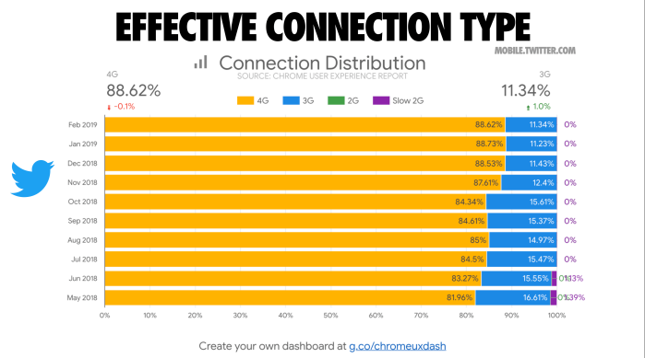
Notes:
Rick Viscomi talks about in terms of the
chrome user experience report here is a
breakdown of the effective connection
type for a really big global site this
is Twitter and as we can see we've
got users predominantly accessing
twitter.com over 4G not that many people
on 3G seems like you know people who've
got fairly good network connections we
can also take a look at the effect of
connection breakdowns for a site like

Slide 9
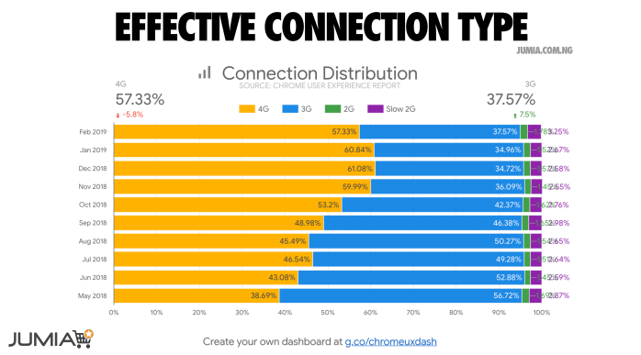
Notes:
Junia over in Nigeria Jimmy is a really
big site over there there you know
proliferation for 4G is not quite as
strong as for twitter.com and in the
countries accessing it it's about 47%
it's about 57% now the reason I was
mentioning that the fast connection is
not always fast is that although we
often hear conversations these days
about you know 4G and even 5g store
needs get more traction around the globe

Slide 10
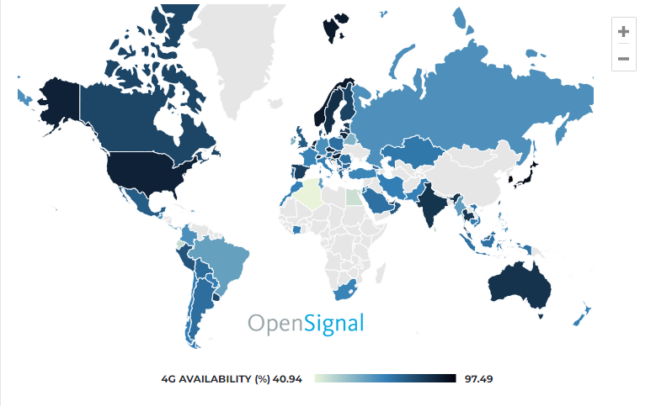
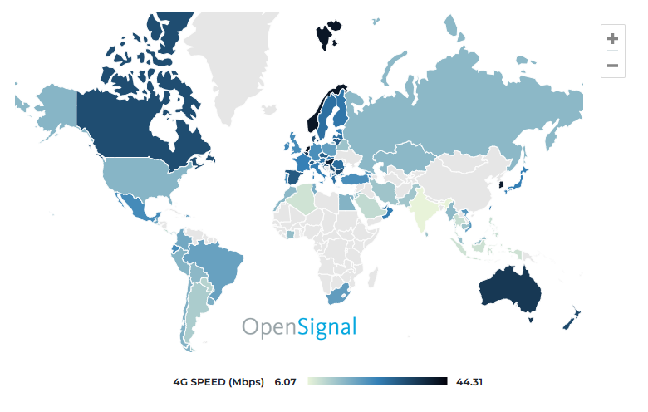
GLOBAL 4G AVILABILITY VS SPEED
Notes:
it's very uneven here's a chart from
open signal that shows how consistently
4G networks are globally available and
the average connection speed that users
have on those networks now countries
that perform better in the metric or
shaded darker what we can see here is
that there's still a huge amount of
variance and network connectivity speeds
so if we're talking about network
transfer that's still an important thing

Slide 11

Notes:
when we're thinking about the size of
our JavaScript bundles let's switch
things over and talk about CPU so
javascript is CPU bound the biggest
bottleneck in modern mobile web
performance is CPU about half of the web
is being accessed on devices where we
don't always have the strongest CPUs
don't always have the strongest
batteries and so while transmit sizes
end up being important for slower
networks JavaScript execution time is
something we have to keep in mind for
phones and devices with slower CPUs

Slide 12

Notes:
Now speaking phones
let's talk about phones
a lot of us in this room are probably
lucky enough to have a high-end device
you probably have a number of people
here with iPhones or pixel phones or
something in this similar class

Slide 13
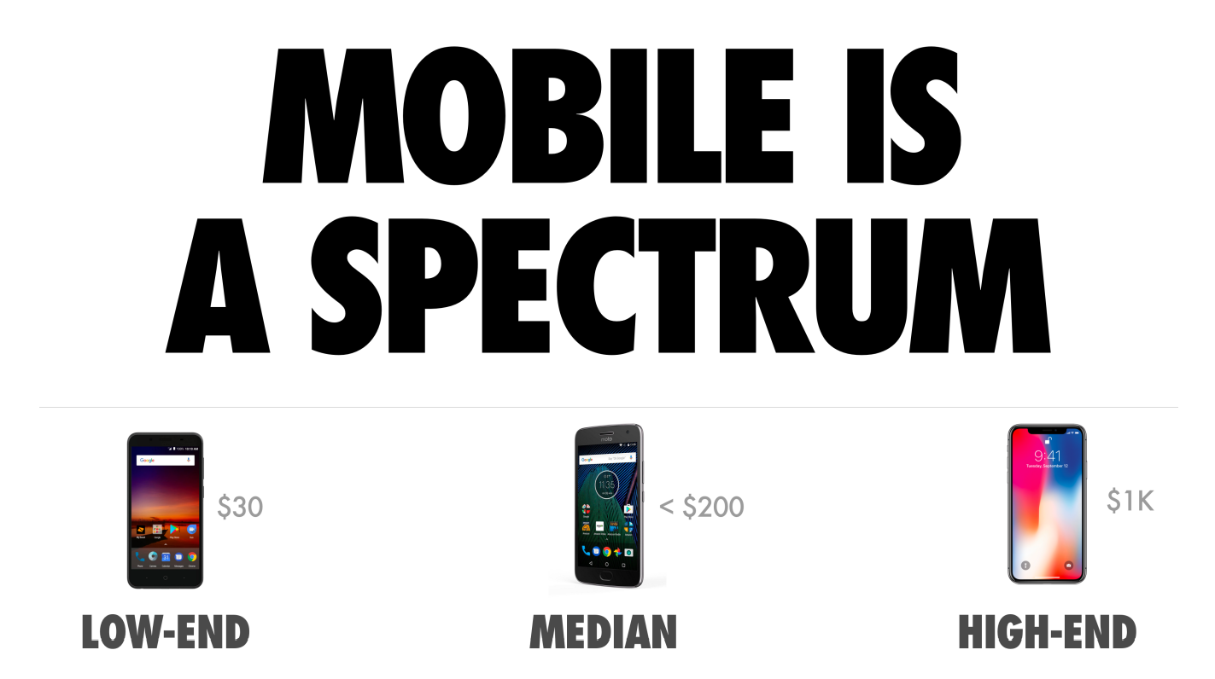
Notes:
However mobile is a spectrum and it's an uneven
spectrum at that there is a huge
difference between a low-end phone that
cost $30 and something that's closer to
$1,000 differences in thermal throttling
cache sizes CPU GPU the ability for
these phones to be able to process
JavaScript can vary quite a lot in fact

Slide 14
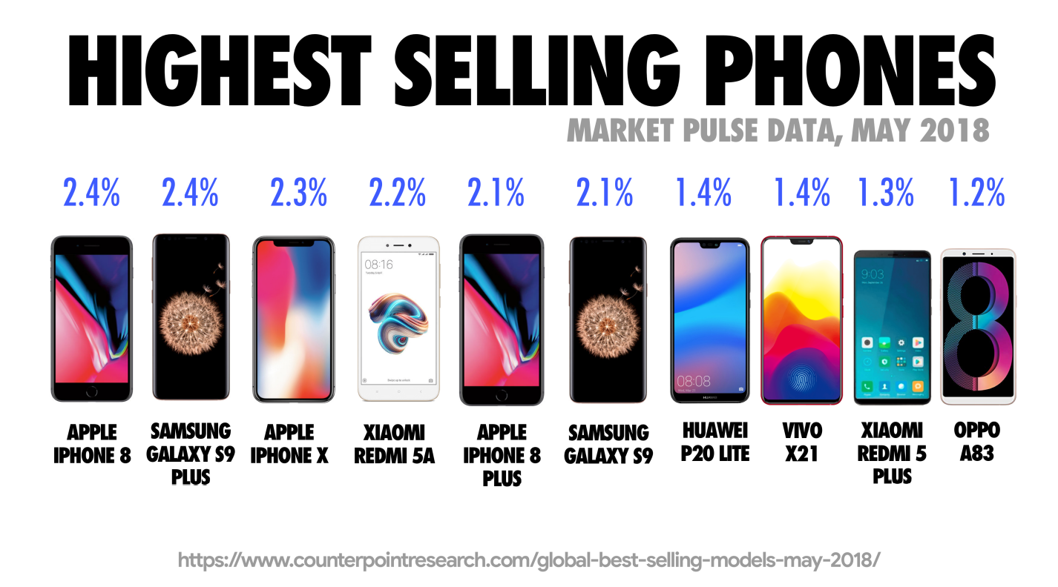
Notes:
let's dig into this data a little bit
more here's a charting of the highest
selling phones globally from last year
what you'll see in here are phones like
you know the iPhone 8 the iPhone X but
there's also a lot of Android devices in here
There's a lot of devices that are
much slower than iPhones

Slide 15
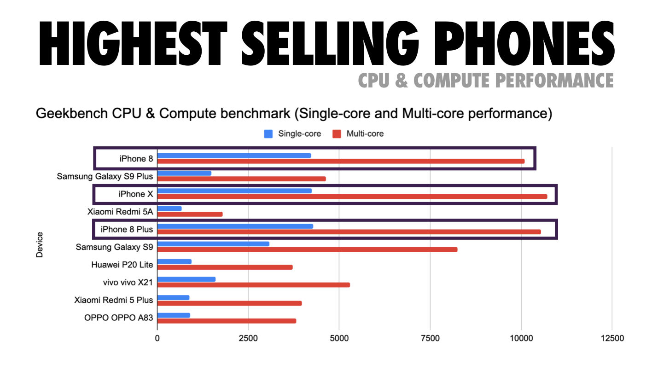
Notes:
That forth phone the ziomedia a that was the most
popular phone in India last year now
let's try to quantify this the Apple
iPhone has got an a 11 processor chip in
there maybe you know that maybe you
don't it's got two high-performance
cores and that allows it to do things
like process JavaScript really quickly
let's take a quick look at the CPU
performance of these devices and for
this we can use a benchmark called geek
bench so geek bench is a popular
benchmark and separates single core and
multi core performance tries to simulate
real-world scenarios what we can see is
that the CPU performance for something
like the iPhone is vastly different to
that for the sigh me read my 5a or any
of the Galaxy phones that you or your
family may have we can you know
sometimes when I talk to people about
CPU performance they'll say you know
this is this is more of an emerging
markets problem everybody here has got a
fast advice I don't really need to worry
about this but that's not strictly the
case if we take a look at Best Buy's
top-selling phone list this is from this
week by the way we see that the two
devices on this list are the LG stylo
three plus and the Galaxy S 10 these
phones vary wildly in their price but if
you take a look at the CPU performance a
single core and multi-core the LG stylo
which is under $200 performs so much
slower than the galaxy phone so what
does any of this have to do with
JavaScript's well to explain that we

Slide 16

Notes:
Have to dive to how browsers work just a little bit
so I talk about a web browser called chrome
and when you're sending files down to
the browser it looks like this model

Slide 17
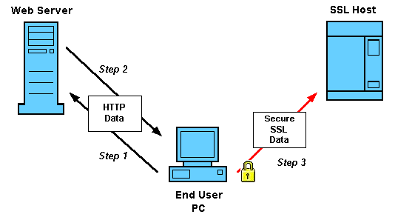
FAMILIAR ?? EVERYTHING THROW BY HTTP

Slide 18

Notes:
For each request on HTTP we will have resonpose as expected. But no

Slide 19

Notes:
Actually, you will get many of response from server. this gets even worse with http2
multiplexing while there's still a lot of script being sent down

Slide 20

Notes:
Now I
I love JavaScript but my position on it
is it's probably the most expensive part of our sites today
Much more expensive than
resources like images or fonts and it's
it's got a very different cost to it byte for byte
it's more one of the most
expensive things you can be sending down

Slide 21
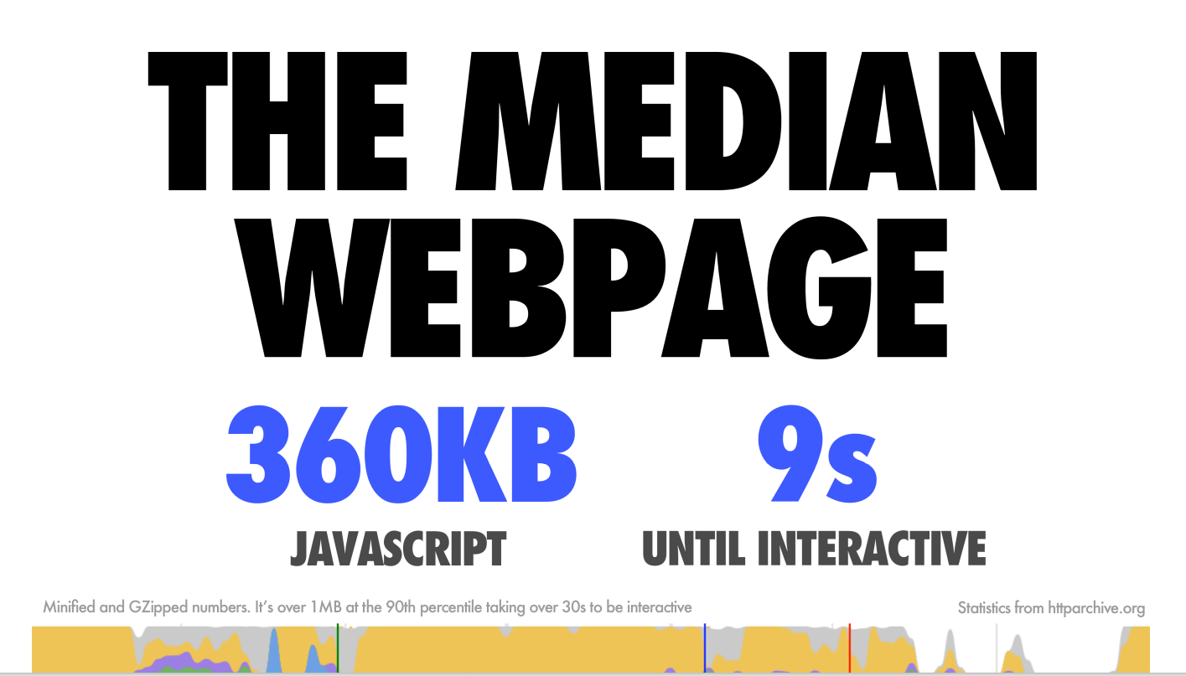
Notes:
let's take a look at some more stats so
according to the HTTPArchive the median
webpage is shipping down 360 kilobytes
of compressed script to users these
sites take about nine seconds before a
user can interact with them and if we
take a look at the uncompressed numbers
for this 360 kilobytes will bloat up to
you know well over a megabyte of
compressed script the devices have to process

Slide 22
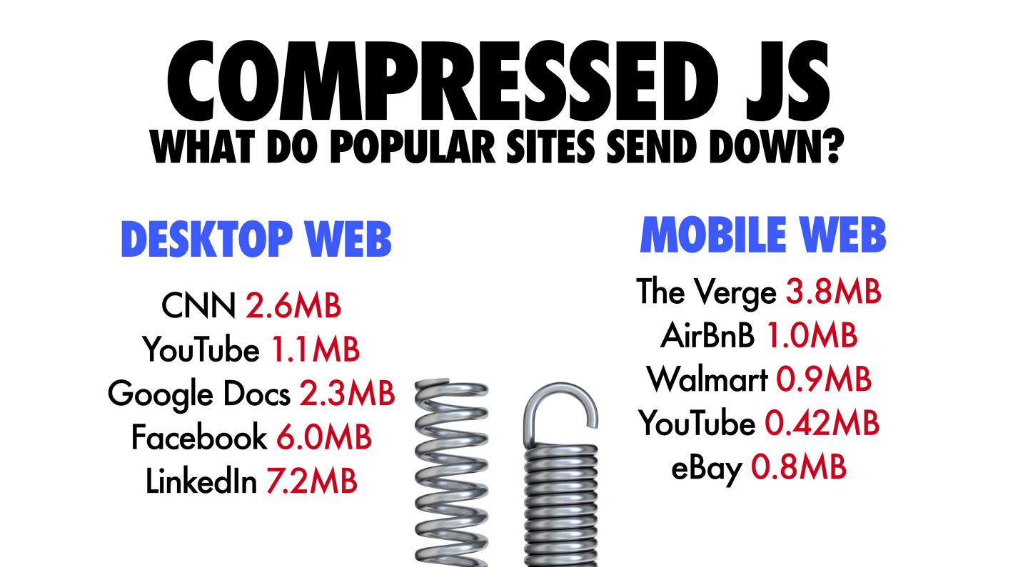
Notes:
We can take a look as well at
say popular sites so popular sites are
reaching this interesting cliff where
they seems to be okay shipping down
megabytes and megabytes of JavaScript to
our users CNN is stripping down 2.6 Megabytes
The verge three point eight megabytes and the real question is can
you afford to send down this much script
to your users when we're trying to add
interactivity to our pages.

Slide 23
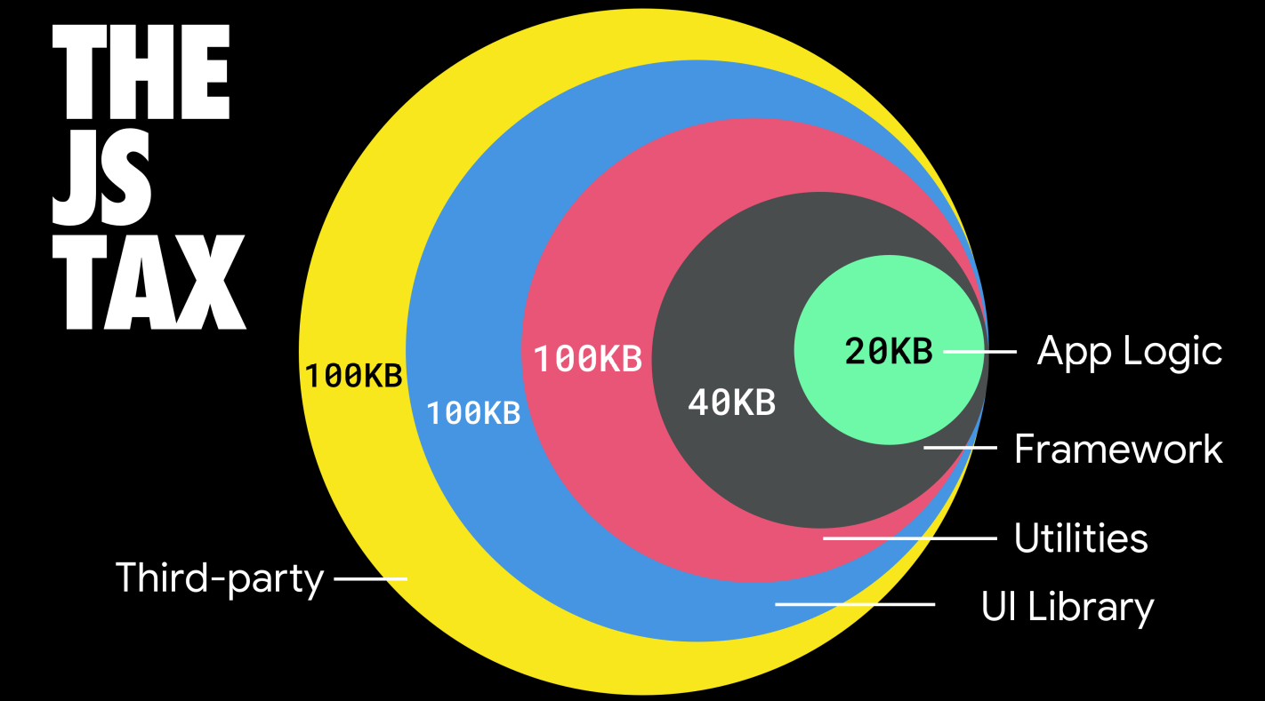
Notes:
Today we're often paying a JavaScript tax so what is
it that we're sending down we generally
have some level of page logic or
application logic we have our UI library
our framework utilities you can easily think of things
you've built to probably have a router
in place maybe they're using moment JS
other utilities you know maybe have
a UI library maybe you'll have third
parties in place.
But all of these things add up in cost and it's important to
think about whether that cost is
something that's actually delivering value to your user
Now, what impact does shipping down a lot of javascript have
on the user experience

Slide 24
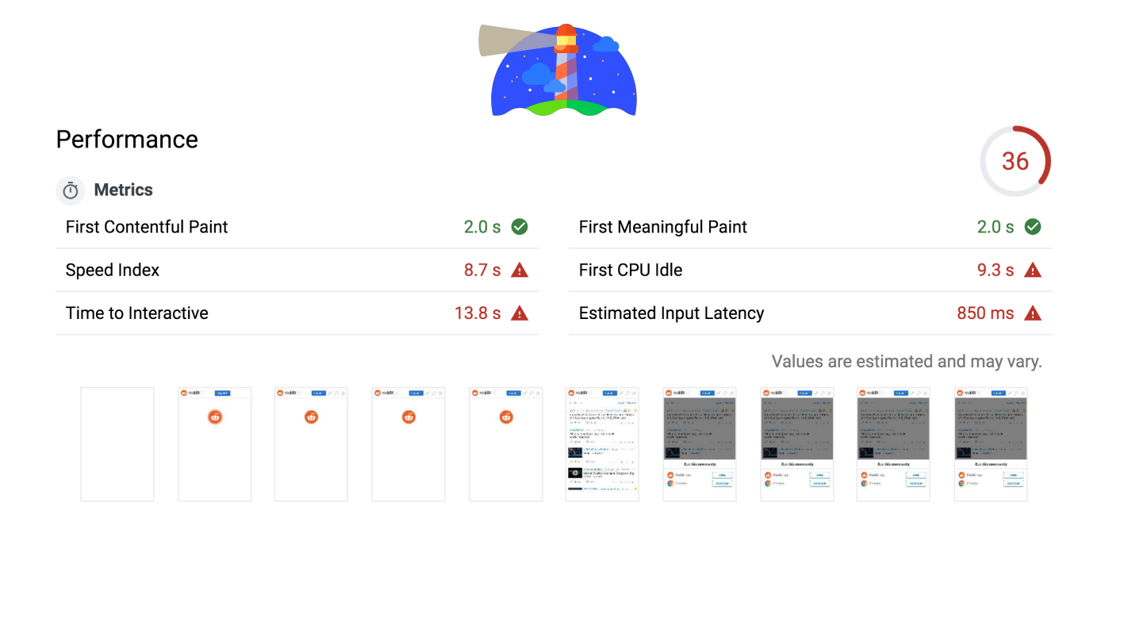
Notes:
Well some of you might be familiar with lighthouse it's
our auditing tool baked into the chrome
dev tools it's available via the audits
panel lighthouse has this time strip at
the very top that exposes metrics about
the user experience

Slide 25
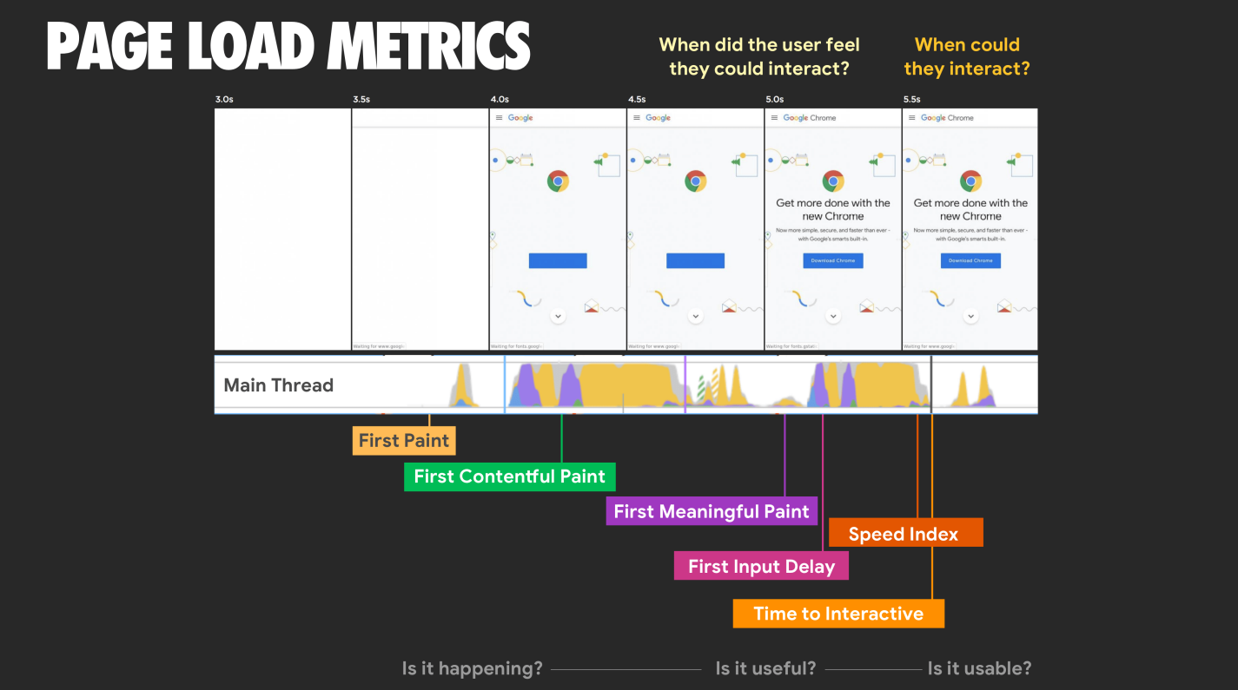
Notes:
Now over the last couple of week I've been evolving my
Understand of what it means to load a webpage and
I've kind of broken it down into three
buckets for metric so if you know is it
happening is it useful and is it you is
it usable and is it useful to users now
is it happening at that point when you
know maybe you've painted something on
the screen is it useful is when you've
provided you know primary text content
primary image content and is it usable
as that point when the user can actually
interact with the experience and how
something happened.

Slide 26
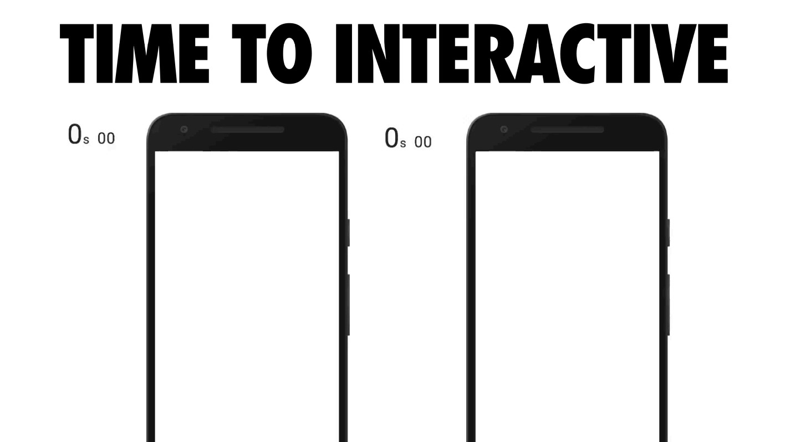

Slide 27
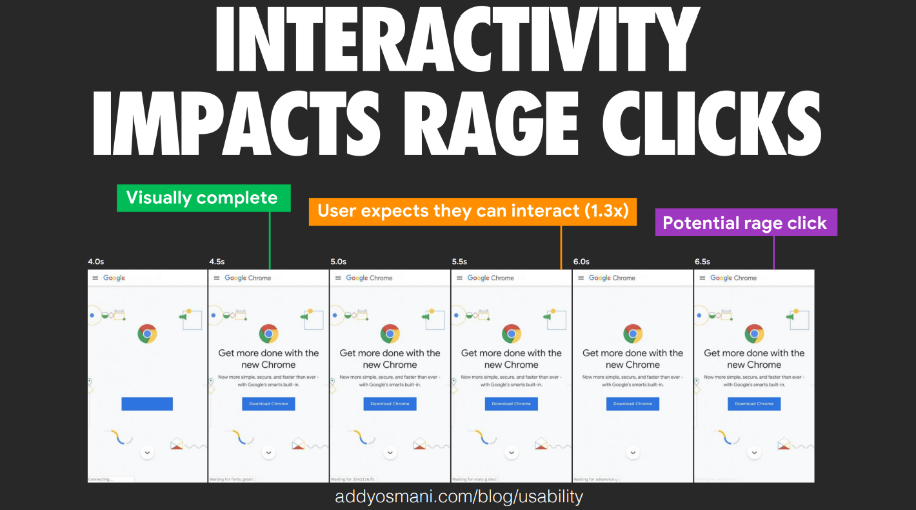
Notes:
Now if the idea of a time to interactive
and metric is something that still
confuses you here here's a visualization
of it now for a page to be interactive
It has to be capable of responding very
quickly to user input whether that user
is you know tapping on a link tapping on
a custom component if they can't
response the page quickly then it's not
really interactive and there's a good
chance that they're gonna end up leaving
your experience

Slide 28
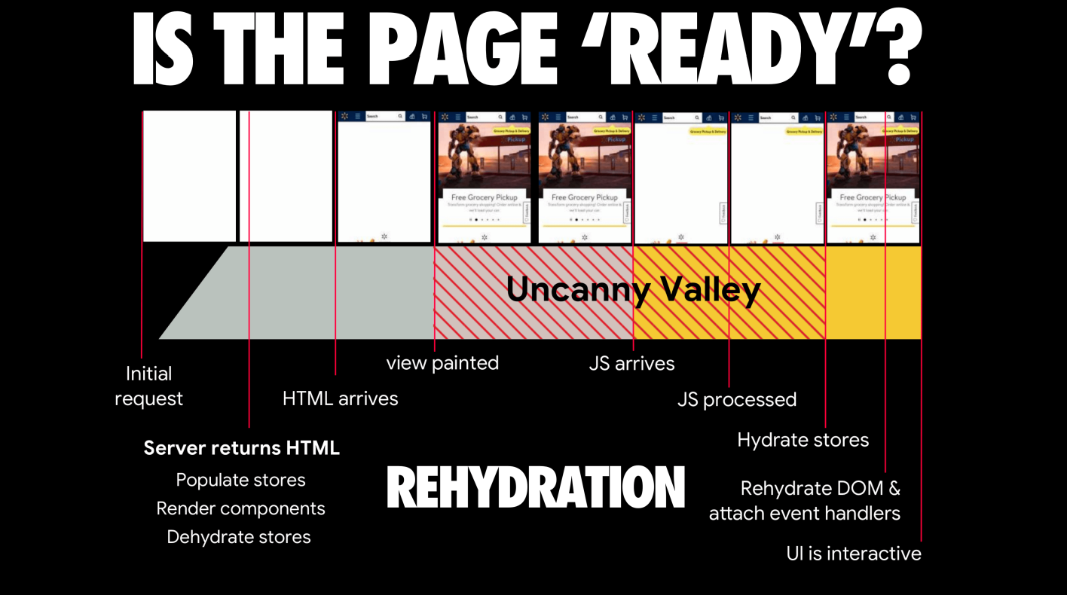
Notes:
Another place that we commonly see the cost of JavaScript
actually impacting things is rehydration
so if you're familiar with you know
client-side rendering or
server-side rendering rehydration is
this idea that tries to kind of combine
client-side and server-side rendering by
doing both of them so server-side render
pages often look like they're ready and
like you can interact with them but you
can't actually do that until all the
client-side JavaScript is executed until
those event handlers have been attached
and that can sometimes take seconds on
mobile

Slide 29
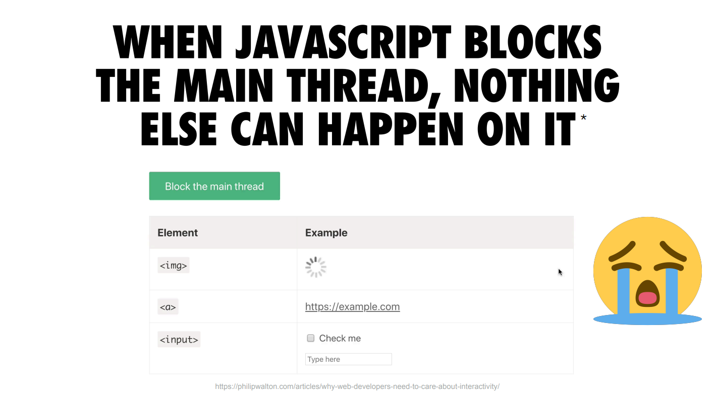
Notes:
Now when JavaScript ends up blocking the
main thread and almost nothing else can
happen on it this is something that we
need to keep in mind as we're building
experiences for folks now when the above
code is running it's not just blocking
other JavaScript code it's blocking all
of the other tasks on the main thread
and that can include other so-called
native things so if I am trying to track
with a checkbox the main thread is
blocked I may not even be able to do
that you might be wondering well how do
I work around this problem and one way
to do it one way to avoid things that
can push out your time to interactive is
keeping an eye on long tasks so long
tasks are tasks that end up monopolizing
the UI thread there are things that take
over 50 milliseconds to complete and
they can block other critical tasks for
being executed even if your page looks
like it's visually ready so one thing
you can do is try to break up some of
those longer tasks split up your code
prioritize the loading of your code a
little bit more more carefully and if
you can reduce those long tasks

Slide 30
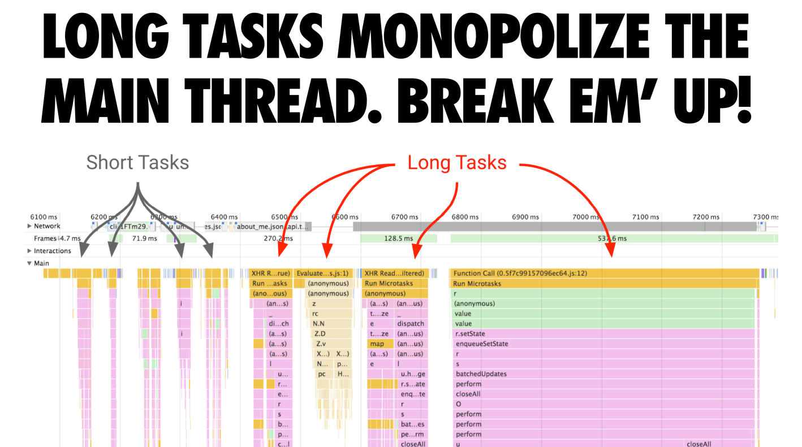
Notes:
Hopefully they'll have less of an impact
on input latency for folks who you know
have got a little bit less experience
with the dev tools performance panel and
are not really sure how to identify long
tasks we actually just landed a change
in the chrome dev tools whereby if you
hover over a long bar of work will tell
you if it's got if it's causing long
tasks you can then expand that work out
you can see what scripts what functions
were necessary we're involved in pushing
the work out and you can start to try
optimising that in some cases rather
than work you know doing a bunch of work
a synchronous leading the same task you
can break those up to much smaller
things

Slide 31
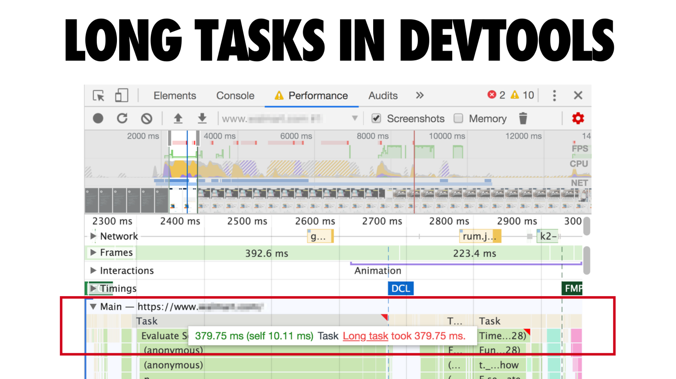

Slide 32

Notes:
Now in terms of how long you know
you should aim for getting interactive in
I say getting interactive in five
seconds on average mobile hardware
something like a moto G 4
fast 3G or slow for G's or generally a
good target this person isn't actually
interacting with the phone they're going
through withdrawal symptoms there's
nothing nothing on the phone so we want
to design for resilience

Slide 33


Slide 34
Notes:
We want to try building experiences where the cost of
JavaScript is not really hampering our users
but is actually empowering them to
do more so how can we do that
Now to get a better understanding of what this
means behind the scenes for JavaScript
engines let's talk a little bit more
once again about how browsers work

Slide 35
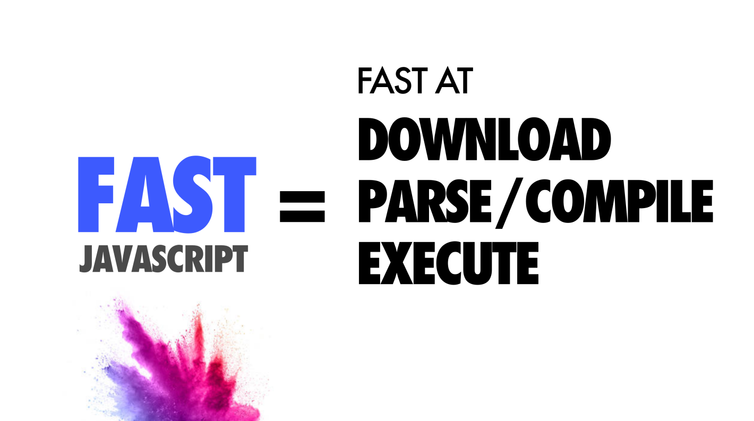
Notes:
So, you type in an address into the URL bar
and you hit go.
It fires off a request to
some server somewhere you go through
your DNS TLS resolutions and everything
and at some point maybe you will get
some HTML sent back down
parse the HTML
they'll start to send down some
resources for the page
then the browser has to process it
it looks pretty much exactly like this we have to crunch all
of your resources so the browser can
understand it and start to actually do
something with all of that script that
you're sending down now once we've
finished processing that script
hopefully you'll get something rendered
on the screen if it was script bound if
the main threads been blocked maybe you
end up interacting with this page and
nothing actually ends up happening so
JavaScript can be a real bottleneck and
it's something that we do need to think
about as we're building out these modern
experiences
Now, if you want to be fast
at JavaScript you need to be fast at
three things
You need to be fast at
downloading that script parsing and
compiling that script and then executing that script
If you're spending a very long time downloading and executing code
that can heavily delay how soon a user's
going to be able to interact with your experience

Slide 36
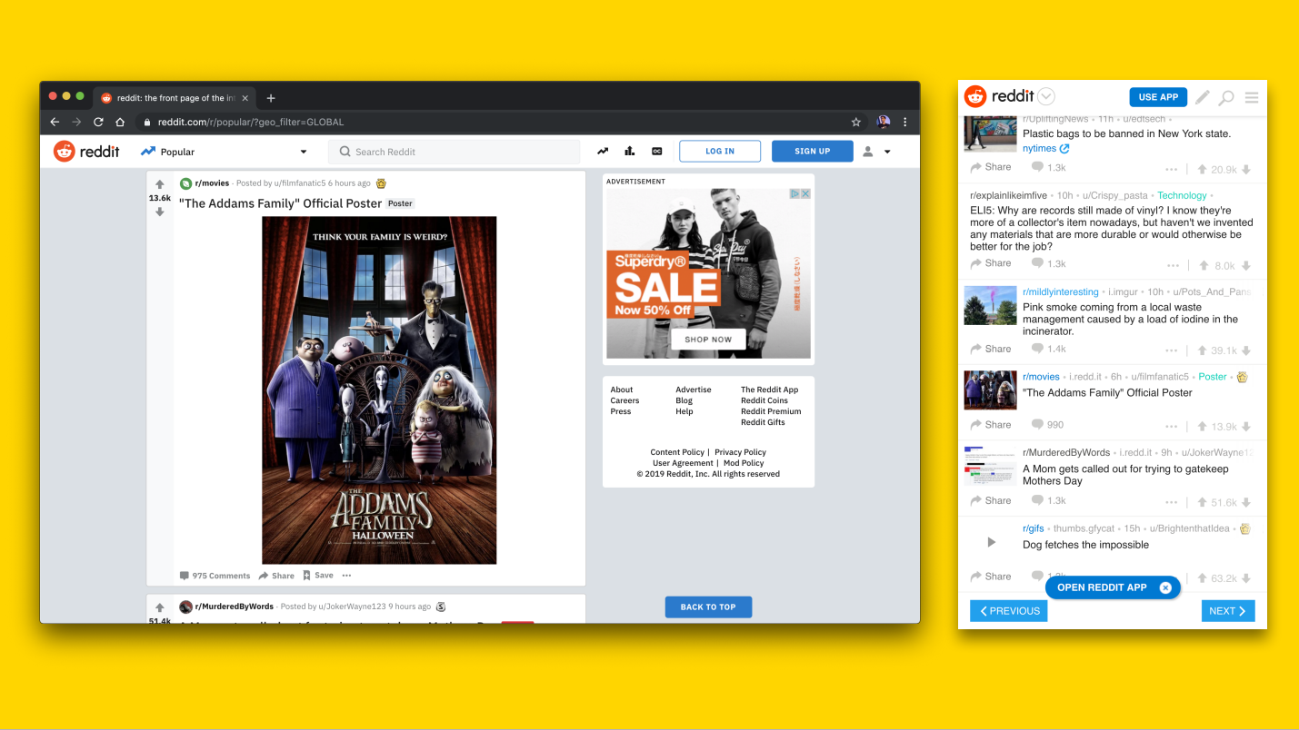
Notes:
Let's take a look at a real world example something
non-controversial like Reddit so so reddit has got kind of two experiences
on desktop it ships one version of its
site and then on mobile is ships another
version of its site which has this
lovely kind of prompt to install their
native app won't talk about but if we
just take a look at kind of where reddit
com is spending its time in v8 Chrome's
JavaScript engine

Slide 37
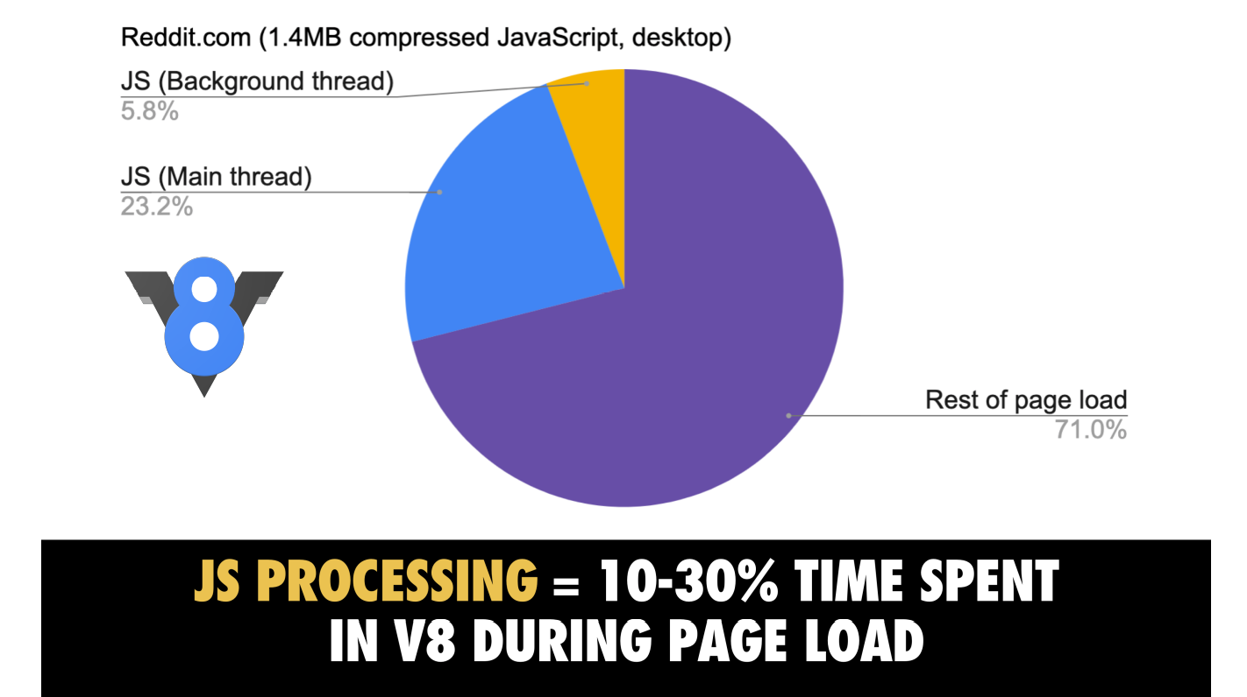
Notes:
We can see that
it spends up to 30% of its time just
processing script 30% that's a that's a
pretty significant.
Right now I wanted to point your
attention to sort of the blue in the
yellow areas now the thing that really
matters here is the main thread time
How much time on the main thread are they
spending I've also gotten yellow this
other thing called background thread
time now

Slide 38

Notes:
In most of the articals I read
about the cost of JavaScript I don't
really see about background threads or
what that even means so hopefully this
is new to you
I'll try to explain it
we're gonna get a little bit into the weeds on this one
for for a hot second
this is gonna feel a little bit like
your experience you know trying to read
a manual for putting together an
appliance whenever I read one of those
manuals and it tells me that it's gonna
be easy I feel like you know it's really
lying to me pretty badly so hopefully
that won't be your experience with us

Slide 39
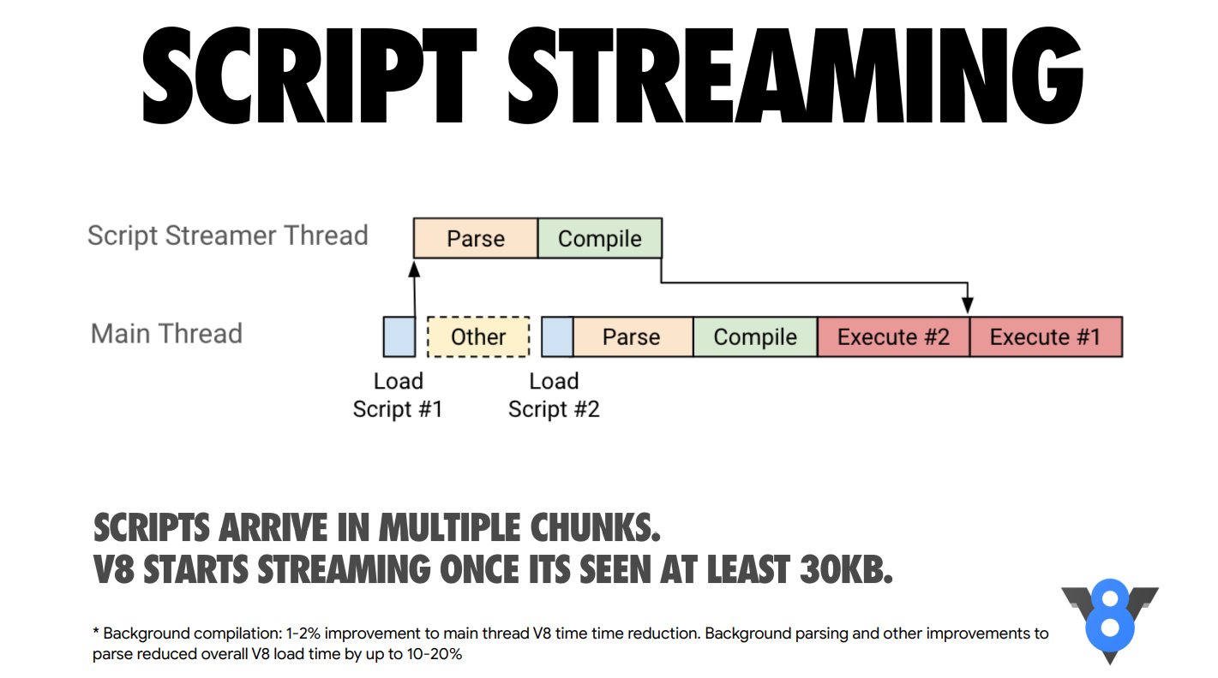
Notes:
When we talk about background threads
what we're really talking about in
chromium based browsers this idea of
script streaming so in much older
versions of Chrome we had this idea
where you know we'd first of all
download a script before beginning to
parse and compile it and unfortunately
that didn't really take full advantage
of the CPU around chromemium
We introduced this idea of script streaming
and the idea there was that we would
parse async and defer scripts on a
completely separate thread as soon as the download began
Now the benefits of being able to start moving more of our
work to the background have been pretty substantial we first of all moved
More of our parsing into the background and
then we did it for compilation
Now, background compilation gave us the
ability to improve main thread time by
2% background parsing
And other improvements we've been able to make the
parsing have improved load time spent in v8 by
up to 20% now in more recent versions of Chrome
We've actually continued to evolve this idea of script streaming
In chrome 71 we moved to a task based setup where we could actually
parse multiple async and deferred scripts at one time
That led to a three percent improvement in time to
interactive for for a large swath of Pages
And it reduced main threads time up to 40% we're continuing to kind of
build on this idea as much as we can but that kind of explains where that
background thread is

Slide 40
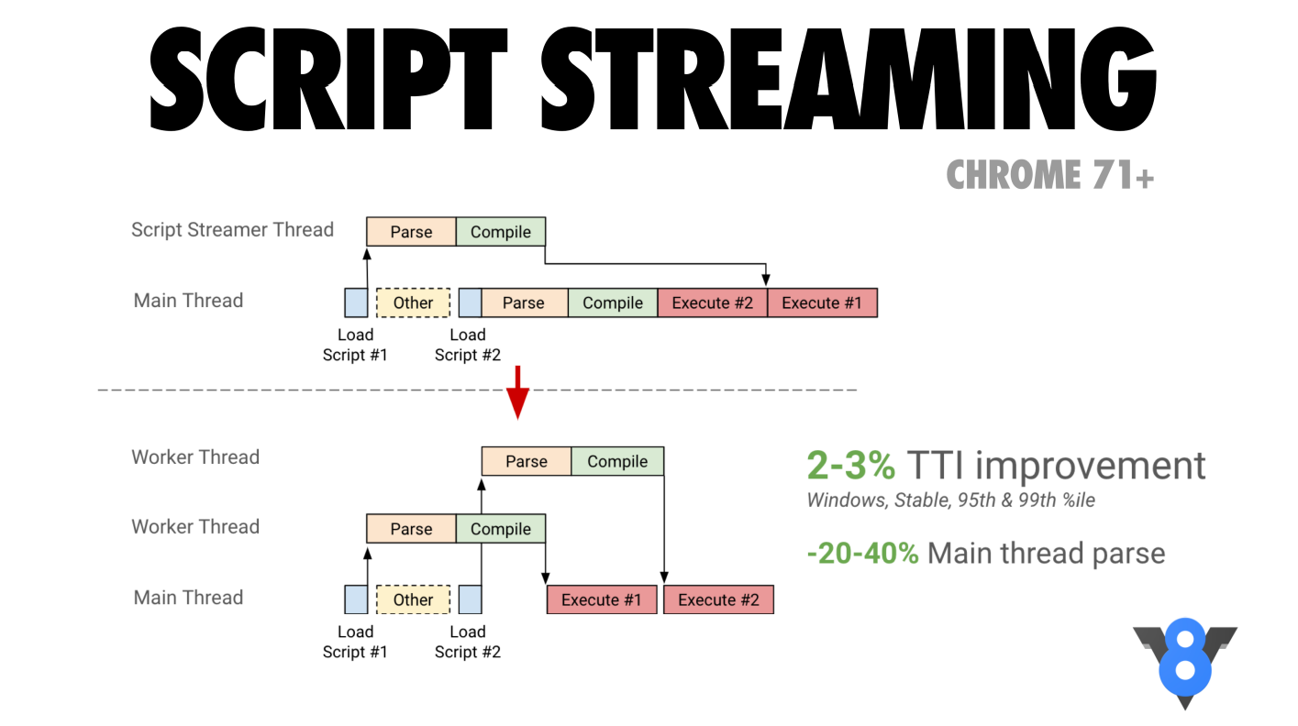

Slide 41
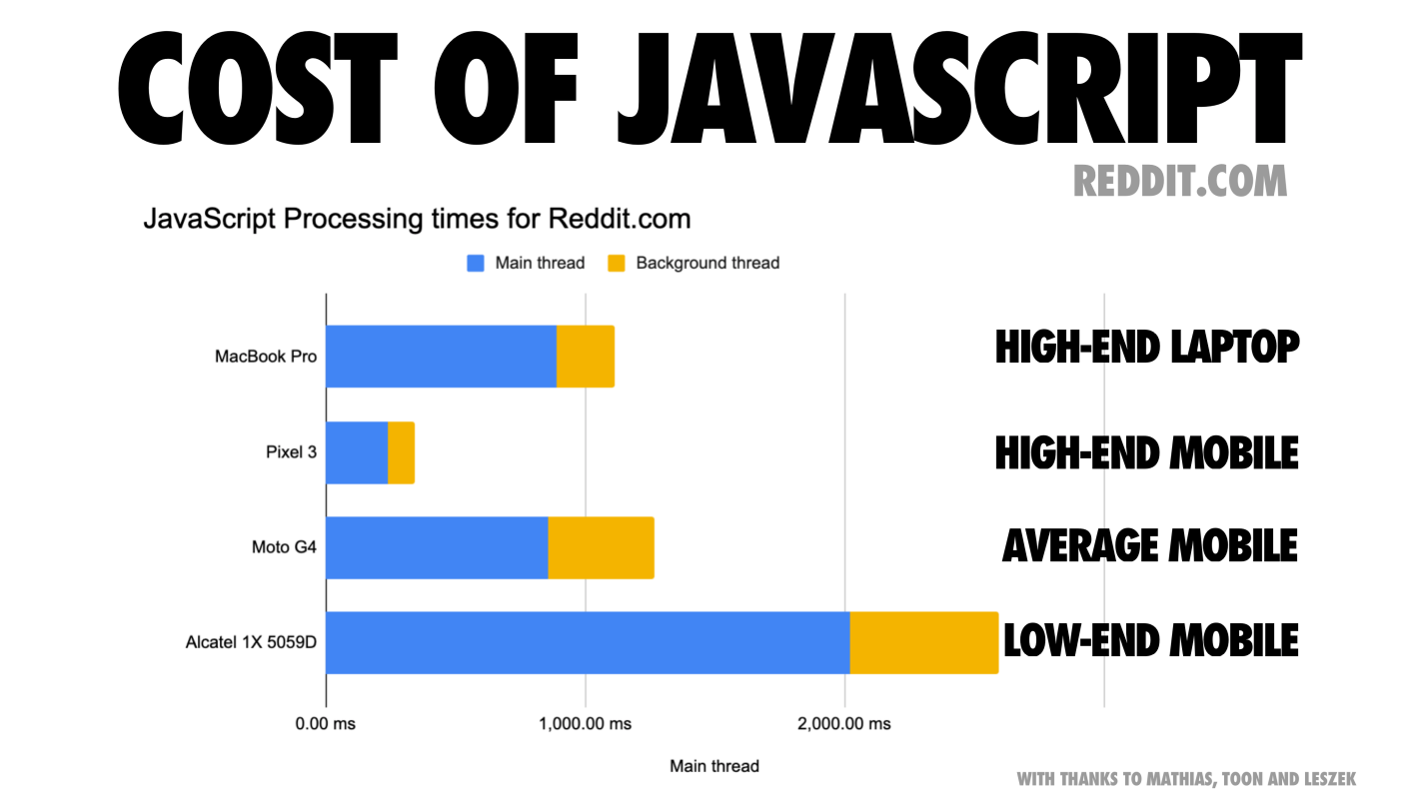
Notes:
If you ever look inside dev tools it's the background
thread time that corresponds to scripts
streaming so let's
take a look at some new charts for
reddit.com
this is where it's spending its time on
a MacBook Pro at the very top it's
spending multiple seconds just
processing JavaScript on the main thread
this is a huge amount of time compared to
You know what some other sites are
doing it's a lot of time being spent not
spending a lot of time on the background thread.
We take a look at their mobile
experience which really you know if
we're comparing apples to apples is the
is the last three of these we see that
processing time on a high-end device
like a pixel 3 is relatively quick processing time on an average phone like
a moto g4 is like 3 or 4 times as slow
and then it gets even even slower if we
look at a sub $100 phone like the
Alcatel One X

Slide 42
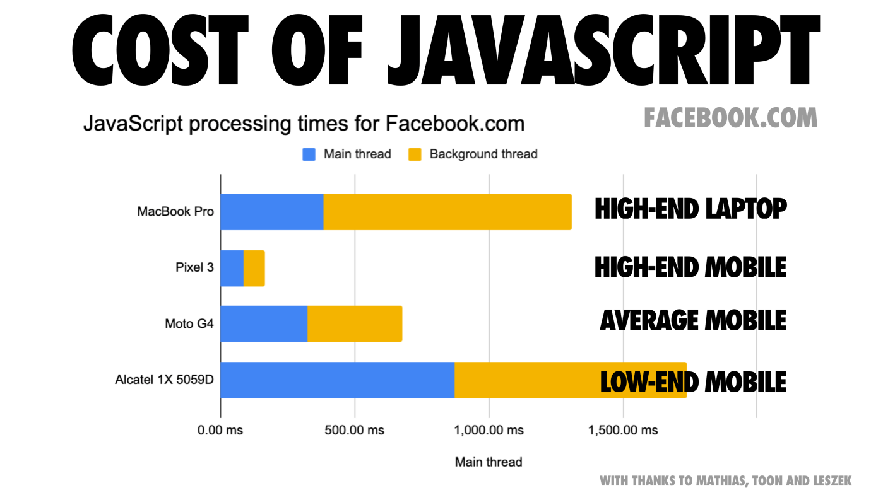
Notes:
We can also take a look for fun at facebook.com/ and now we'll
notice that this change is up just a
little bit facebook.com are spending a lot of time
This is again MacBook Pro
for their desktop site they're spending
a lot of time processing JavaScript but
only a small portion of it is spent on
the main thread quite a lot of it is
spent in the background we see a similar
skew between you know the performance of
this site on mobile devices let's try to
unpack why we're seeing such a big
difference between Reddit and Facebook

Slide 43
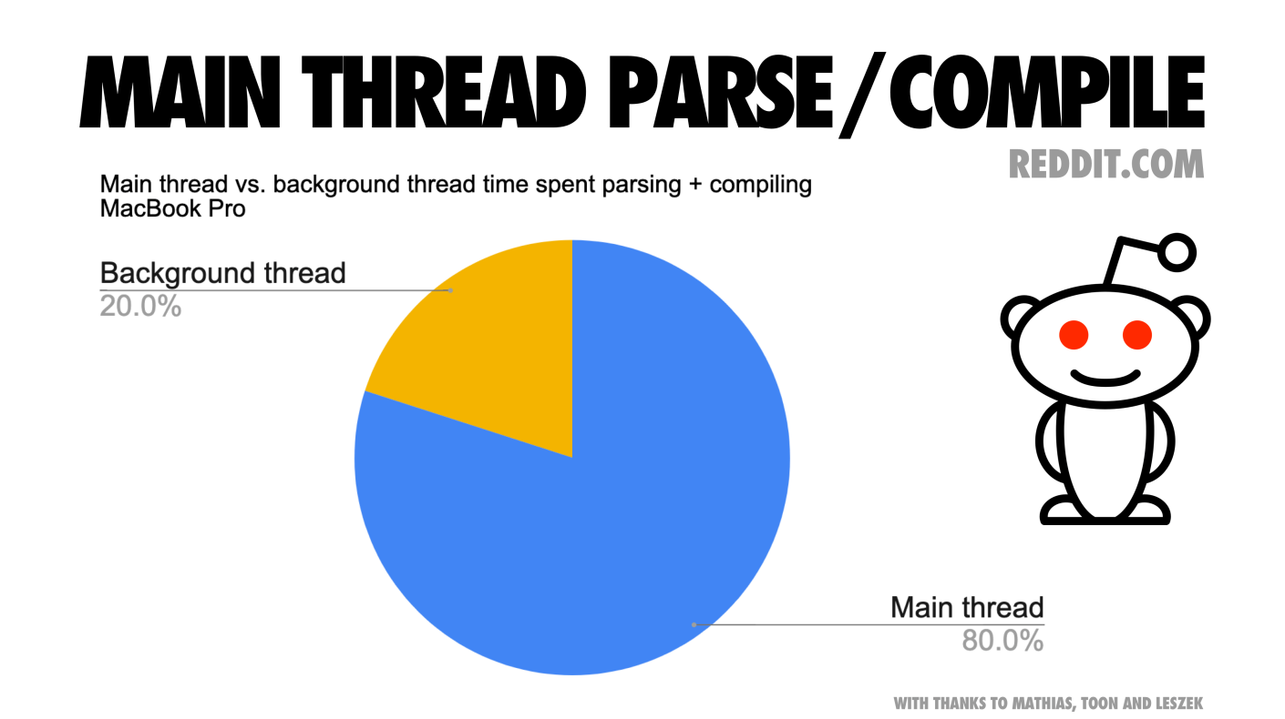
Notes:
So one thing reddit are doing is they're
shipping very large JavaScript bundles
down to their users.
These are multi hundred kilobyte bundles and those
bundles they're wrapped and outer functions that's causing some lazy
compilation on the main thread they could probably benefit from splitting
those bundles up into much smaller bundles say 50 kilobytes

Slide 44
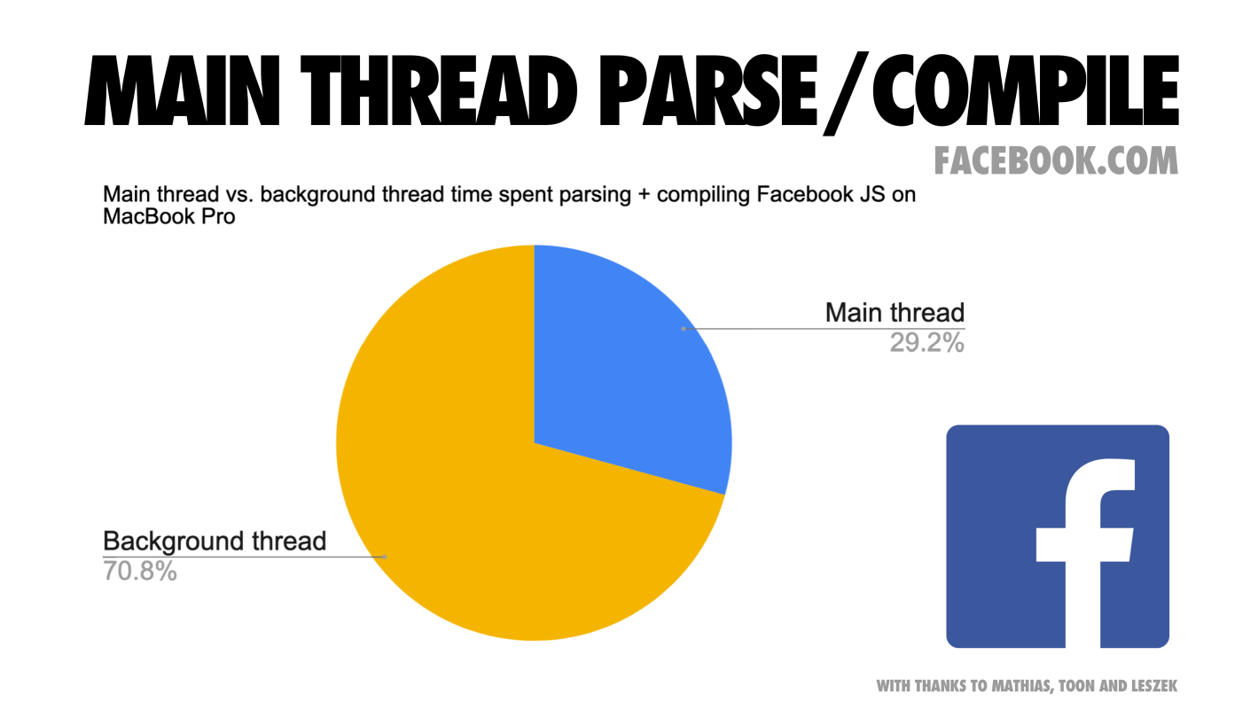
Notes:
Now the 50 kilobyte number is actually
interesting because when we talk about
v8 script streaming we actually start
streaming once we see 30 kilobytes of
code and to maximize parallelization you
actually you know benefit from splitting
things up
And I'm much more granular in
much more coarse way so read I've got
large bundles Facebook are spending 70%
of their JavaScript processing time in
the background thread now here's where
things get really fun they're actually
shipping six megabytes worth of script
down across two hundred and 292 requests
That's a
of script but what's happening in
Facebook's case is that they've got
their scripts so coarse that they're
actually able to maximize
parallelization maximize our ability to
process and compile everything on those
background threads.

Slide 45
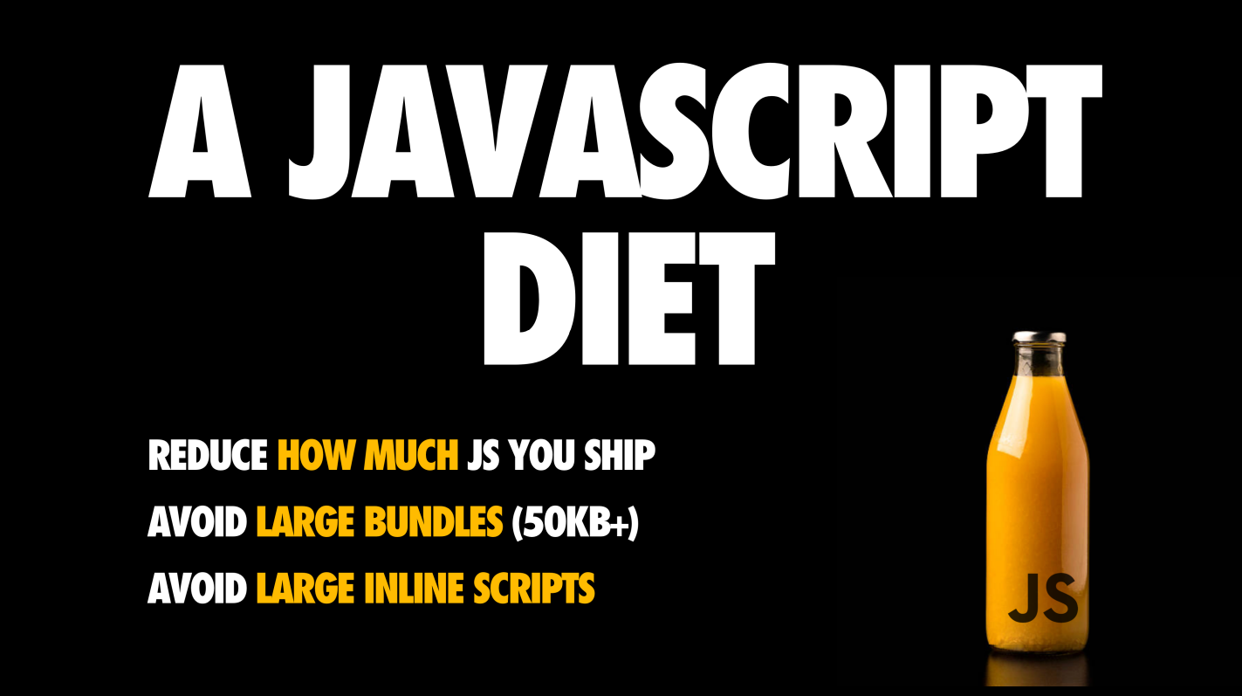
Notes:
Now you're probably not Facebook you're probably not you
know something like a Gmail where you're
a long-lived app so maybe don't ship six
megabytes of JavaScript down across
almost 300 requests but do try to break
up your work
So, if you're trying to
You know, ship if the experience is
efficiently and you want to go on a
JavaScript diet here are three things
you can do you can first of all reduce
how much JavaScript that you shipped
maybe only load the code that the user
needs for the current route.

Slide 46
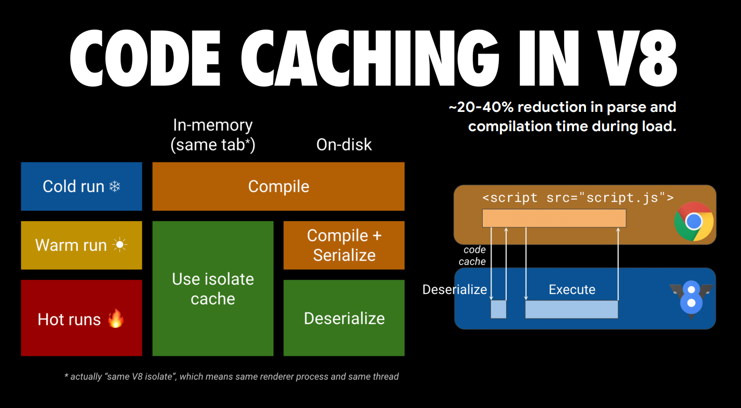
Notes:
so imagine
someone coming back to your site you
know three or four times within 72 hours
we can actually take that as a signal
that that's an experience they're gonna
benefit from you know us store you know
loading a little bit more efficiently
and storing a little bit more byte byte
code around so what we do is if you do
hit and experience three times within 72
hours we'll store metadata about those
strips and we'll store the byte code
representation and we can actually skip
a lot of the cost of parsing and
compiling code and go straight over to
execution time what this means is a 20
to 40 percent improvement in overall
parse and compile during page load you
might be asking great this is a browser
optimization I don't care what do I have
to do to take advantage of this to the
max so one thing that you can do is just
be careful with what you're putting into
your JavaScript bundle

Slide 47
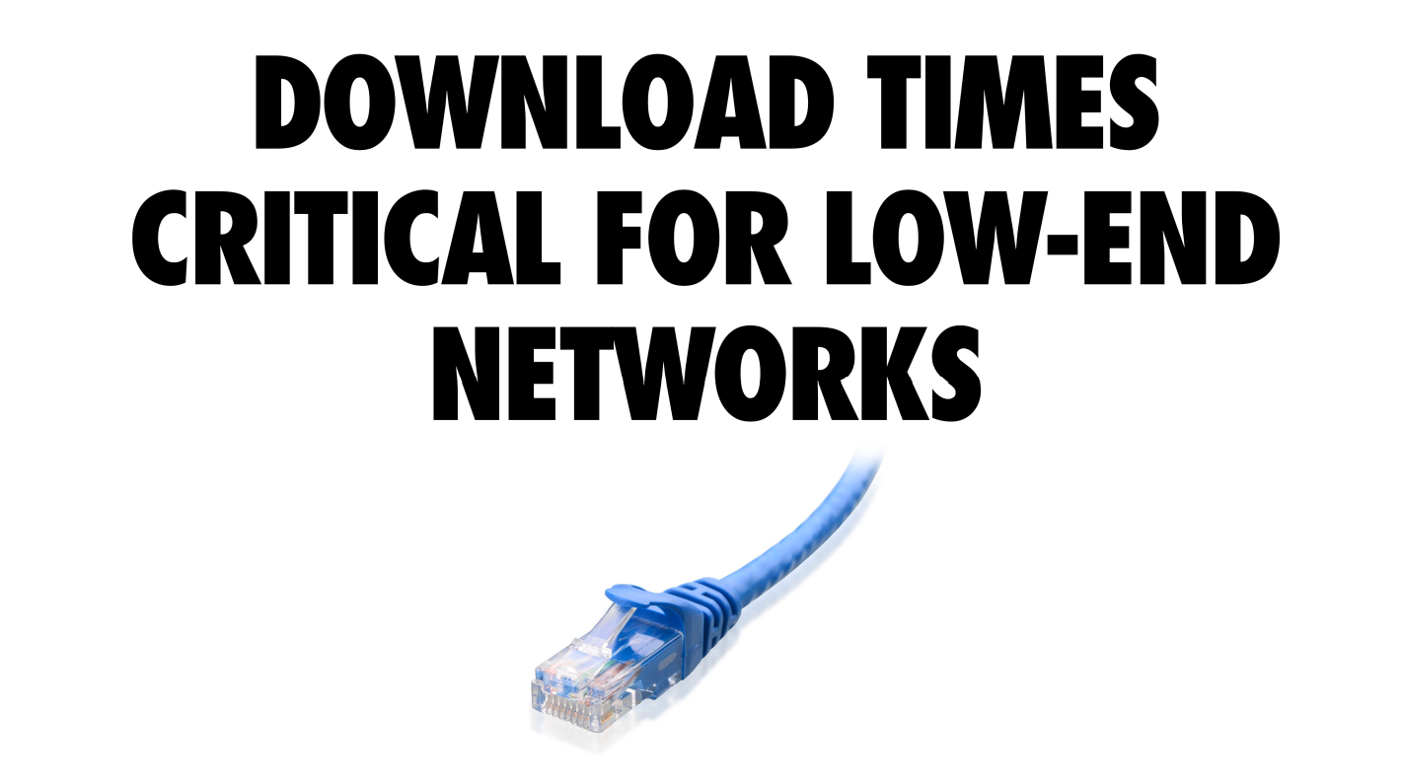
Notes:
So to recap so far download times are
pretty critical for low end networks try
to ship less code minify that code take
advantage of modern compression schemes
like gzip , like brought lee to try
limiting how much you're sending over
the wire javascript execution time is
pretty critical for phones with
cpu’s

Slide 48
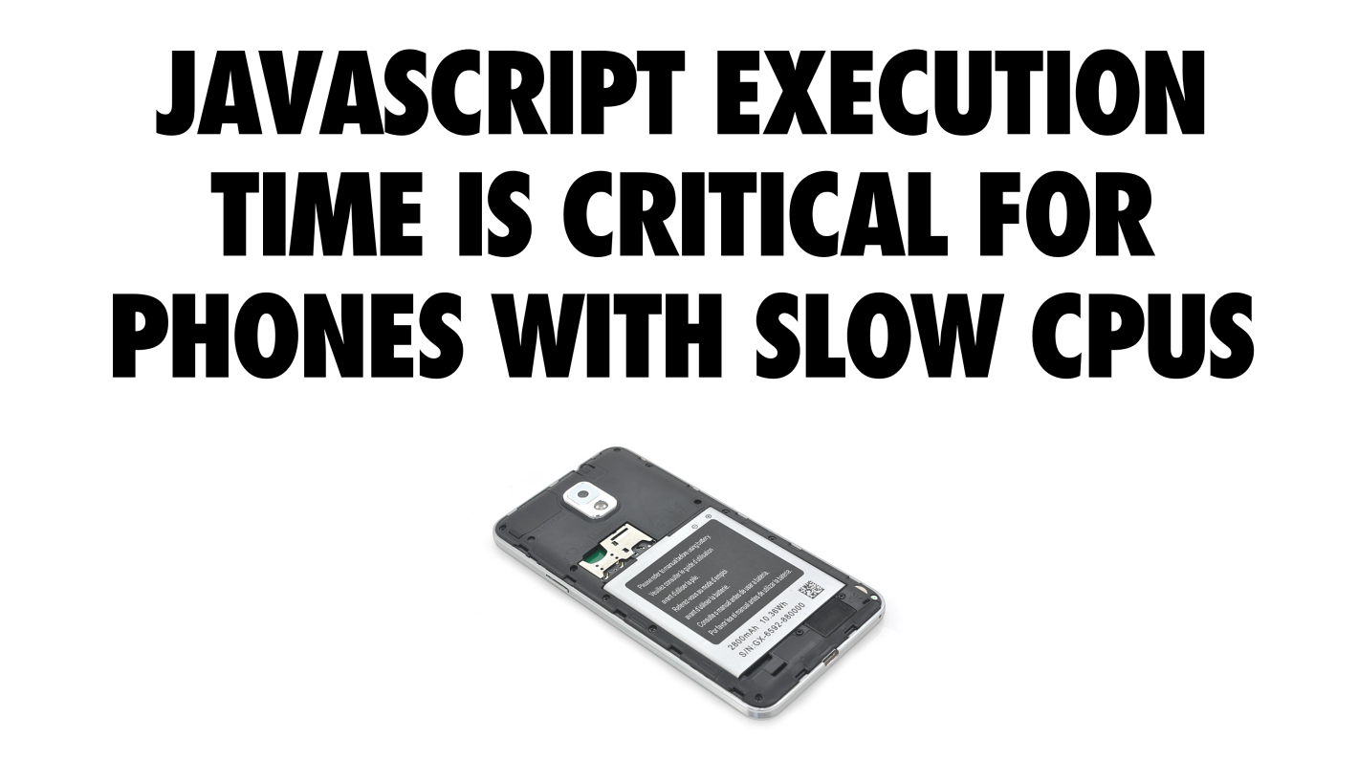
Notes:
So on the server you know in the
past when we've been more focused on
server-side rendering you tend of get
what you pay for in many ways you can
easily see what the CPU cost the disk
cost the network cost is going to be and
as we build sites that are more heavily
based on client side script we sometimes
pay for those experiences in ways that
are not always very transparent and easy
to tell so keep an eye on our JavaScript
execution keep an eye on what you're
sending down to your users

Slide 49

Notes:
now I mentioned earlier that I spend a lot of
time read about
JavaScript also spend a lot of time
taking a look at JavaScript bundles and
questioning what's in them and why so
one thing that you can do to kind of
work around JavaScript bloat is code
splitting

Slide 50
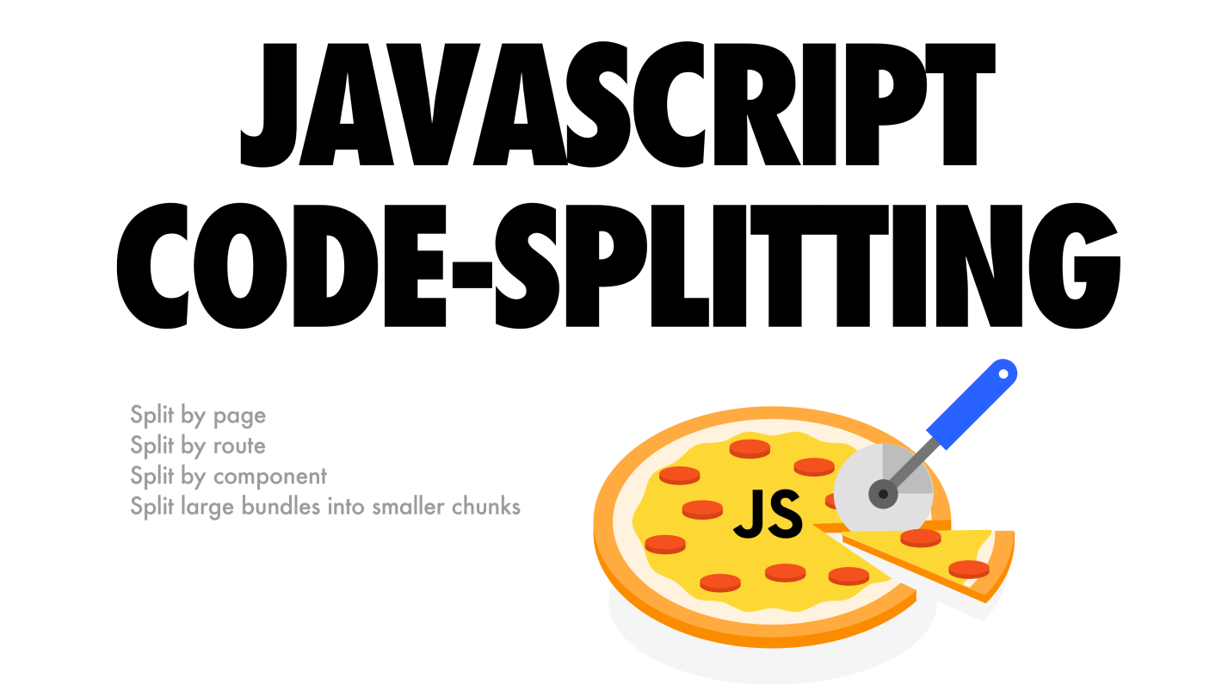
Notes:
now there are many different
approaches you can take to this problem
you can split by page you can split by
route you can split by component if you
want to go really really granular Lee
you can split your large bundles into
very coarse very fine bundles that again
can take advantage of that
parallelization and if folks are less
experienced with what code splitting
means in practice

Slide 51
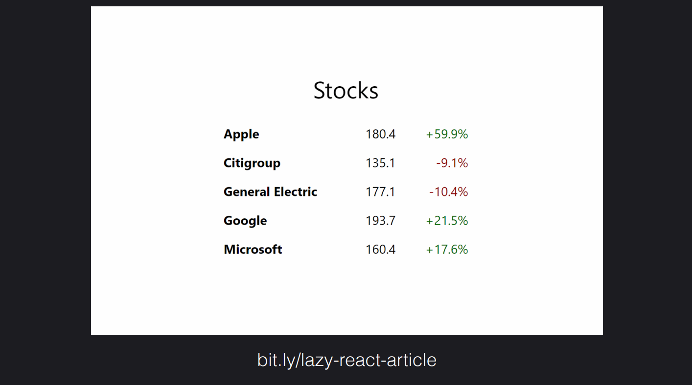
Notes:
here's a very quick example so here we have a stock market
application where if you go and you click on any of those entries it'll open
up this this larger chart component but that chart component is not critical for
the initial load that could be loaded on demand.

Slide 52
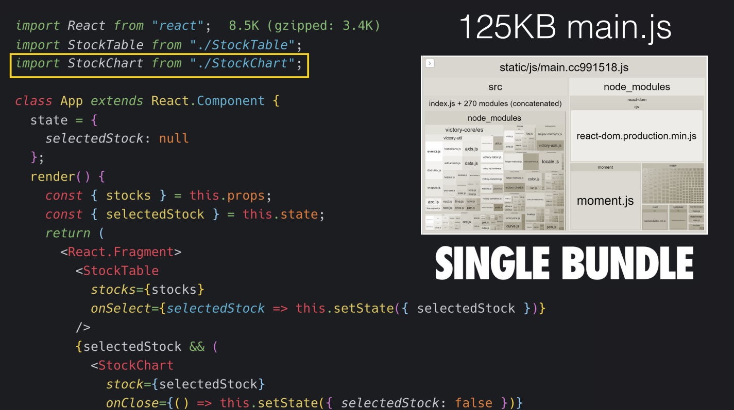
Notes:
And so in this react app we can
move away from statically importing in
that component this is just you know a
static import we're starting off with a
single large bundle where all of our
code for this experience exists in one
single main dot JS file it's about 125
kilobytes in this case

Slide 53
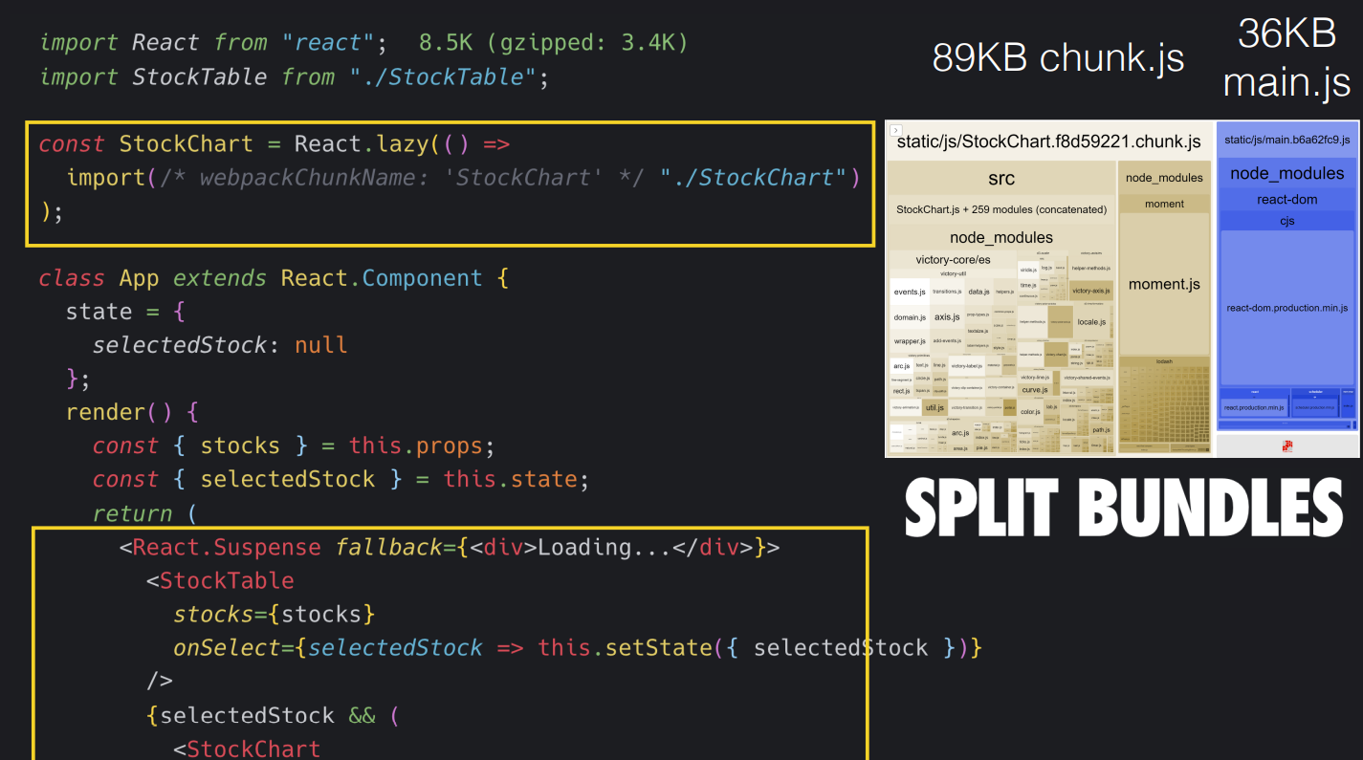
Notes:
And by taking advantage of some of those newer
capabilities that have come to react
such as react out lazy in suspense for
code splitting which you pair with webpack
We can actually split these bundles
up to improve our initial load
performance and improve our time to
interactive so if we break this work up
we can end up with a 36 kilobyte main
script size which is relatively small
and then when the user actually starts
tapping on those individual items to
display that chart we can load that code
on demand so that 89 kilobyte chunk to
be loaded onto.

Slide 54
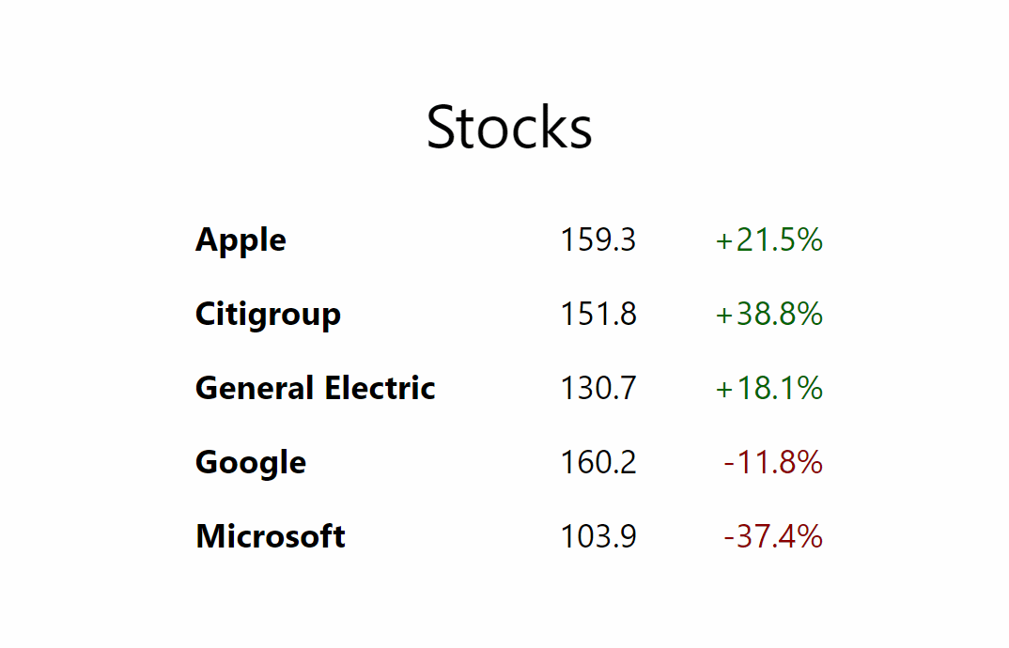
Notes:
and you can do all sorts of interesting
fun and funky things here you could be
prefetching those bundles ahead of time
or using a service worker to caption the
head of time but this is the general
idea just breaking up that work now code
splitting can be done in many many weird
and wonderful ways I've seen people try
things like lazy loading on visibility

Slide 55
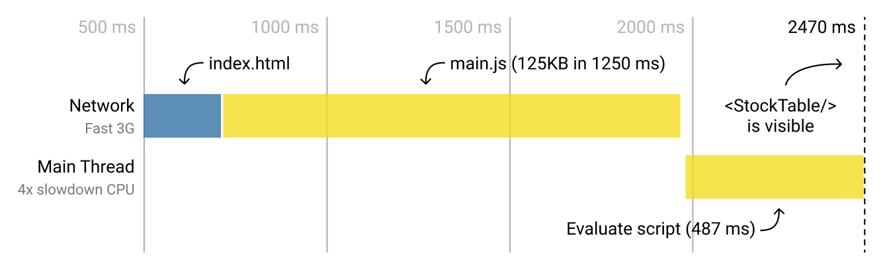
Trace without Lazy loading

Slide 56
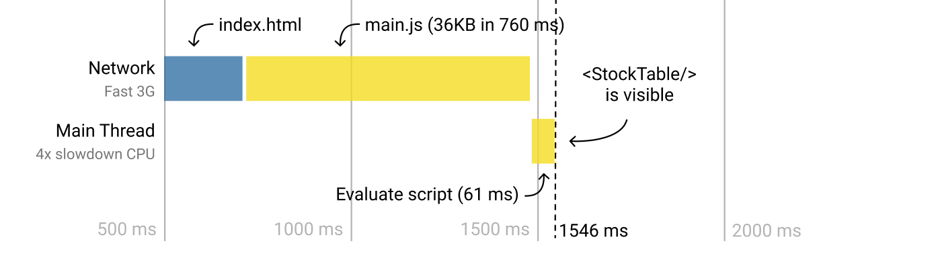
Trace with Lazy loading
Notes:
so you use intersection observer and as
you scroll through the experience as
components come into view you then
decide to you know load any of the
critical path code there it's necessary
to boot them up earlier I mentioned that
the you know the rehydration can be a
problem and so it's been really exciting
to see that many different framework
communities have been talking about
progressive rehydration lately so here
is an example that we have where you
know we're server-side rendering an
application with a very very thin amount
of script necessary to attach the event
handlers to these buttons and when you
tap on any of the buttons that's the
point when we're actually booted you
know we're actually hydrating the
experience hydrating the components were
fetching any of the pet dependencies
that are necessary for the experience

Slide 57
Not good enough? I hate loading

Slide 58
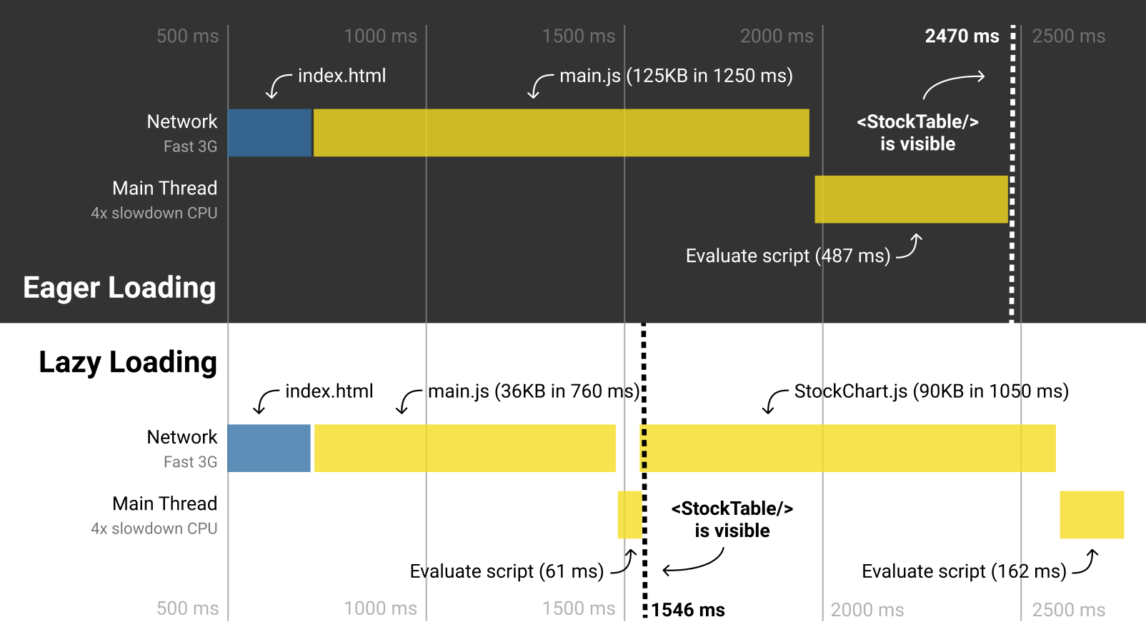
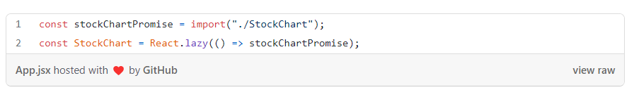
PRELOADING
Notes:
Lazy loading (and preloading) components in React 16.6 | HackerNoon

Slide 59
Rehydrate on interaction or component visibilty
Notes:
and with this approach your individual
pieces of your server-side application
and the booted up over time instead of
that current approach of initializing
your entire application at one time so
you're hydrating on interaction instead

Slide 60
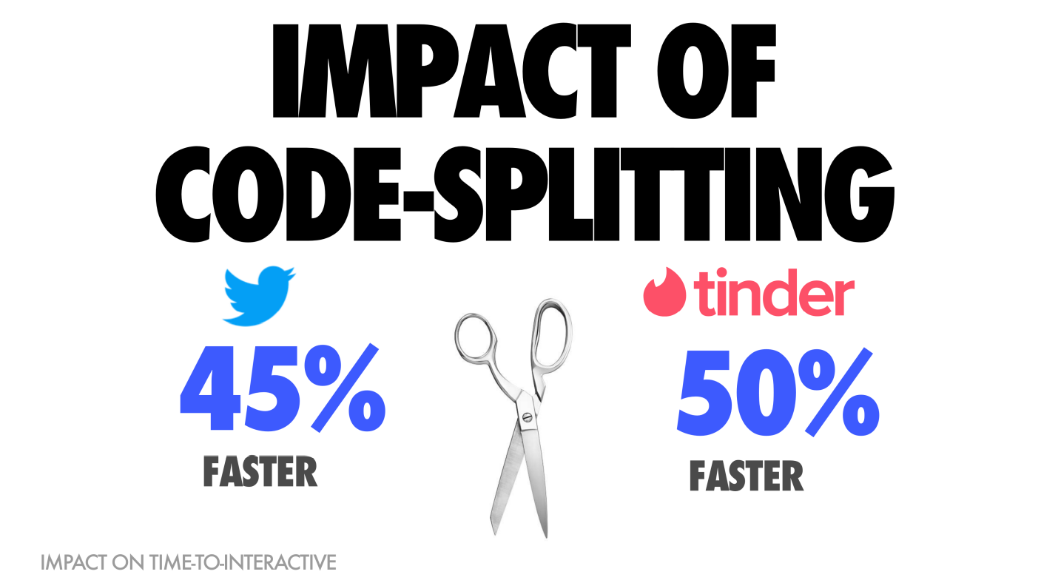
Notes:
the last couple of years we've seen
quite a lot of sites adopted both
twitter and tinder were able to improve
their TTI's by almost 50% by adopting
code splitting
Twitter's in a really interesting place
they now have 40 or 50 on-demand chunks
that are loaded as you kind of navigate
through the experience so you're not
paying that upfront cost of all of the
script at one time now if you're not
really sure where to start with code
splitting or what in your experience you
might want to break up the dev tools
have got a code coverage feature that
you can use and the idea here is
basically that you load up your site you
start interacting with it and we'll
continue showing you exactly how much
code was hits like what code pads were
hit what code pads were not and you can
then dive into the sources panel and you
can see okay well maybe maybe these
modules are not really as necessary
maybe these components can be lazy
loaded at some future point in time
continuing with the theme of you know

Slide 61
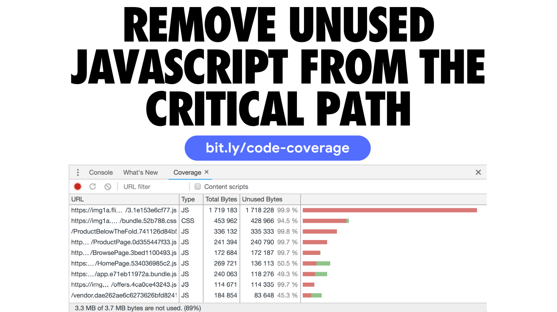

Slide 62


Slide 63
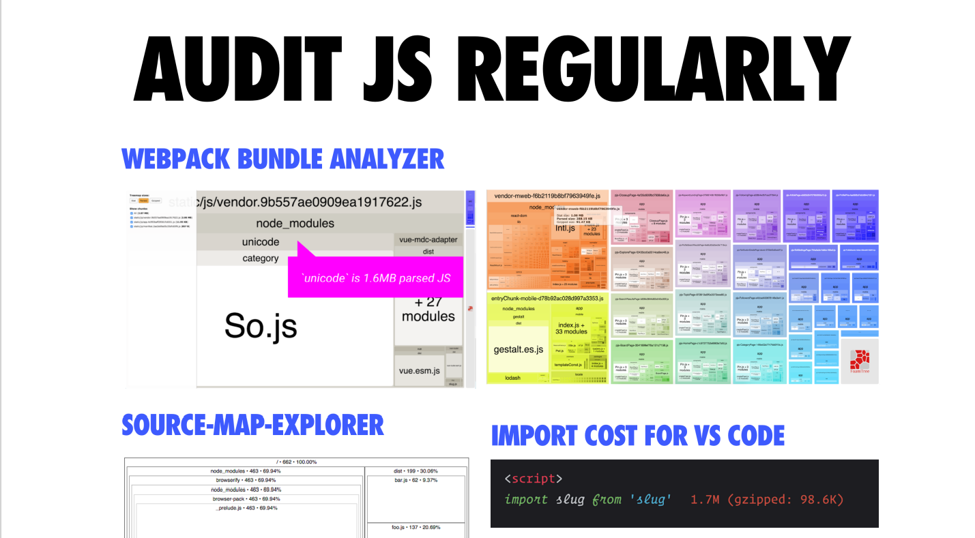
Notes:
Java scripts bundles being quite large I
find myself in this position quite a lot
of just questioning what what is in
those bundles people are sending down
luckily there's some really good tooling
available for folks to check out
something that I use on a daily basis is
web pack bundle analyzer
it's phenomenal tooling it gives you a
really nice visualization of everything
that's in your dependency tree you can
also use a source map Explorer which is
a similar tool but the basic idea is we
often end up NPM installing things into
our experiences without fully
understanding the cost of those.

Slide 64
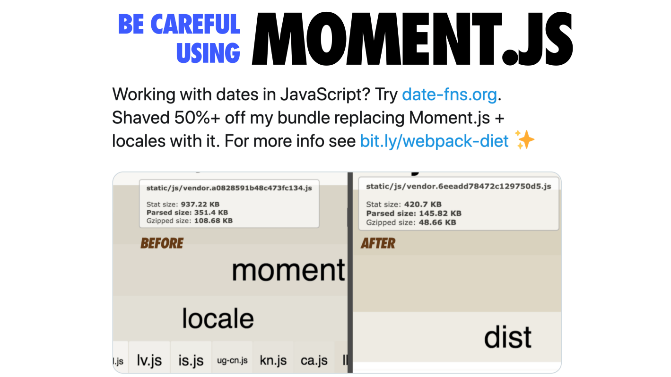
Notes:
I sometimes say that NPM is kind of like
you know the tinder of node modules you
don't really know what you're going to
get so it's it's very important to
understand the cost of each thing that
we're going to install and there's some
good schooling cons take a look at it
some very quick tips be careful when
you're using things like moment j/s in
some of my apps I found that by dropping
momentary asks in place of alternatives
like date FNS or looks on

Slide 65
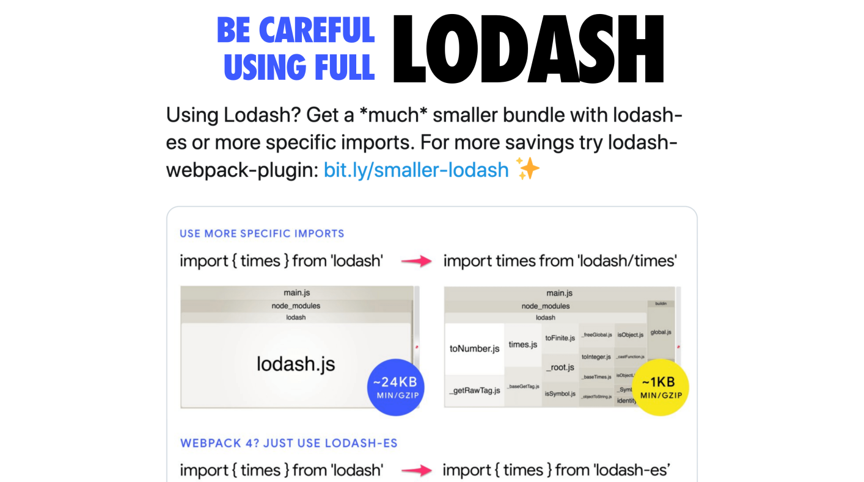
Notes:
I've been able to shave 50% off of my bundles so take
check out sort of some of the
alternatives to moments I think this was
mentioned yesterday but just be careful
with including full-fat lodash you often
don't need all of it and probably just
include the exact methods that you need
and there's some good web pack plugins
that can actually help you kind of strip
away parts of lodash that you don't need
to use so take a look at that as well at
Google we have this this kind of system
that we use called conformance which
enables us when we're building out
applications to kind of flag and say
well here are some best practices that
maybe you should be following here are
some things that maybe you shouldn't be
doing and one of the things that falls
into kind of an interesting place

Slide 66
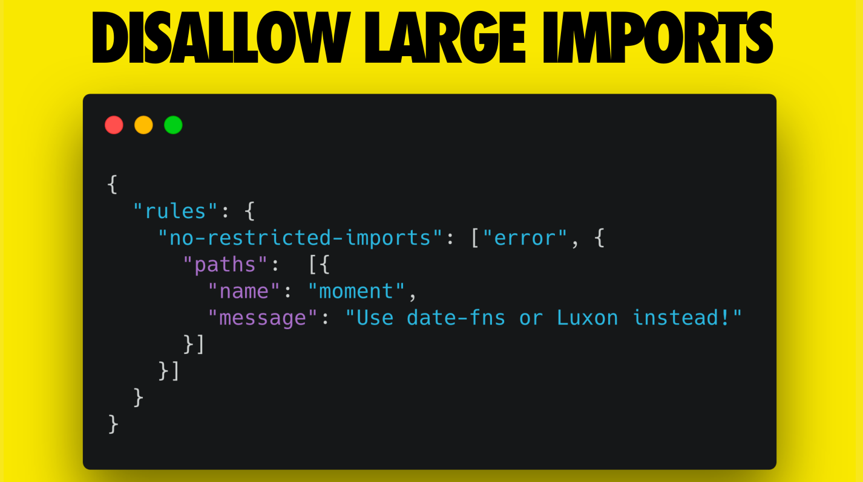
Notes:
There is this notion of maybe disallowing
large imports into our projects so
something you may or may not be familiar
with is the es lint actually has this
really really powerful rule called no
restricted imports and what it allows
you to do as a team is say you know if
there are any packages that I'm going to
import into my page maybe are as a team
we want to say no you can't you can't
import them you have to use these
lighter alternatives but what this will
do is it can either error or warn when
anyone on your team is trying to
introduce a large dependency into the
project I found this really interesting
it's very flexible allows you to add into your own custom
rule

Slide 67

Notes:
So this this next one might be
contentious or it might not be I
personally don't feel like static web
pages need 300 kilobytes of JavaScript
to be good I see a lot of experiences
today where we could just be shipping
down something lean but instead we're
opting for convenience what's convenient
to us in many cases and it's been very
interesting to see kind of other large
sites

Slide 68

Notes:
Understand that this is this is a
problem and there are thankfully some
interesting solutions to it so about a
year ago Netflix did a bunch of analysis
on their non-member landing pages so the
the overall signup flow for signing up
for Netflix and what they discovered was
that although they're using react on the
server side they were paying quite a lot
of a cost on it for some of these entry
pages to the experience and so what they
did was that they removed reacts and
other libraries from their client-side
scripts bundles they replaced it with
vanilla JavaScript and they pre fetched
react for pages further down the funnel
so any of those more complex pages on
Netflix com the video players etc that
you're seeing those are things that
they're prefetching so you can still get
the benefit of using react without
necessarily using it on every single
page

Slide 69

Notes:
For example very recently a
retailer in Indonesia called tokopedia
saw Netflix his case study and they
decided to borrow at leaf
book and do something very similar so
they rewrote their landing pages moving
away from react supporting them over to
spelt and what they discovered was that
between that change out of changes they
were actually able to reduce their
JavaScript bundle sizes for 320
kilobytes down to 37 kilobytes for those
pages a massive improvement now they're
still prefetching reacts for you know
the more complex things further down
their pummel their funnel and the idea
here is just a try finding balance
between you know developer convenience
and user experience one final thought

Slide 70

Notes:
I've got is that I think that you know
this is this kind came up a little bit
yesterday but we we need to make
performance more of the conversation at
our organizations very often the engineering teams that I
speak to end up being the only ones that
own performance or maybe you're the only
you know performance engineer at your
team and you're constantly fighting back
against float and so you know if you're
that person you've probably experienced
this you know this problem of fixing a
site and then a teammate coming over and
just blasting all of your work away like
just fixed it why did you ruin it and so
I think that we need to get to a place
where hopefully between you know
organizational buy-in to performance
quantifying why performance is important
quantifying why individual features and
PRS are important

Slide 71


Slide 72


Notes:
we can start to evolve some of these conversations I talked a
lot about performance budgets and I
think that they they're really important
I see a lot of the sites that I talk to
and they get progressing after a big
amount of performance work and budgets
are great because they help you hold the
line the kind of disagreed set of
targets that you and your team can
strive for and you can set budgets for
all sorts of things you can set budgets
based on timing metrics like times
interactive or FCP and set them for
quantity so javascript bundle sizes you
can set them for rules like lighthouse
Score
And the overall idea is you know
maybe maybe providing more insight for
all of your team members since the cost
of their work is going to help so I see
a lot of people trying to integrate
these concepts into their CI trying to
get dashboards and reports put together
with things like speed curve or caliber
so that they can share performance
and where your falling off the path with
other stakeholders still a lot of
interesting work for us to do evolving
these conversations so I hope that some
of this was useful I'd like us to try to
stop taking things like fast networks
fast CPUs and high amounts of RAM for
granted this is a problem we still run into

Slide 73

Notes:
at Google like I'll have people on
my team we're mostly testing things on
an iPhone or a pixel three but not
devices that are representative of what
like the average person is trying out
there so let's see if we can try to test
more on real phones test more on real
networks I know Pat means in the
audience so webpagetest is really really
great for just validating where your
experience is going to look like on real
world devices with a network that's a
little bit closer to real world as well

Slide 74

Notes:
And one of the reasons this is important
is again those those devices have such
variants they can have differences in
CPU GPU l1 l2 cache and you wanted to
make sure that things that you're
building are going to look really really
good for the end-user at the end of the
day so improving performance is a
journey where lots of small changes can
sometimes end up leading to pretty big
gains so I hope that you take something
from this talk and can apply it to your
real world sites I also hope that you
know at least with the with some of the
more engine specific stuff that it
wasn't to over folks heads oh and it's
also perfectly ok if it was I don't
expect people to go and start trimming
down 90% off the size of their
JavaScript bundles today it's kind of
like you know the experience you have
when someone asks you to go and draw
something like a baby step one might be
drawing the outline of the baby step two
is definitely not this

Slide 75


Slide 76

Notes:
in almost all of my projects my step two
has looked a lot more like this

Slide 77

Notes:
in almost all of my projects my step two
has looked a lot more like this where
I'm just iteratively trying to strip
back some of my dependencies and make a
few small wins that lead up to big gains
so I hope this was useful when in doubt
measure optimize and monitor hope this
was useful thank you
of JavaScript's building interactive
experiences on the web today usually
involves sending an amount of JavaScript
down to your users often too much of it
so today we're gonna talk about why
javascript has got such a high cost and
a few things that you can do to work
around that and still give your users a
really good experience

Slide 78


